Slide 1
NET 536
Network Security
Lecture 7: Transport layer (TLS / SSL) and Email Security ( PGP, S/MIME )

Slide 2
lecture contents:
Transport Layer Security
  SSL Architecture
  TLS Architecture
Email Security
  PGP
    Key Ring
    PGP Certificate
  S/MIME
    S/MIME certificate processing
    cryptographic algorithms

Slide 3
    TRANSPORT-LAYER SECURITY
A transport layer provides end-to-end security services for the application that use a reliable transport layer protocol such as TCP .
The idea is to provide security services for transactions on the Internet.
Example of such a service is when a customer shops online, the following security services are desired:
  The customer needs to be sure that the server belongs to the vendor not an imposter➔ entity authentication.
  Customer and vendor need to be sure of the contents of the message are not modified during transmission➔ message integrity.
  Customer and vendor need to be sure that an imposter doesn’t intercept sensitive information (credit card number )➔ Confidentiality

Slide 4
    TRANSPORT-LAYER SECURITY
Two protocols are dominant today for providing security at the transport layer:
  Secure Sockets Layer (SSL) protocol
  Transport Layer Security (TLS) protocol.

Slide 5
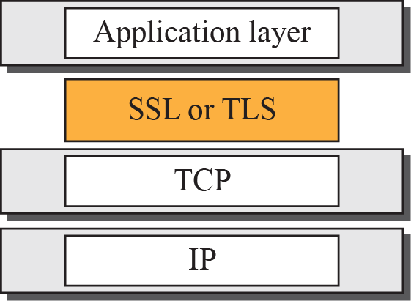
Internet Location of SSL and TLS in the model

Slide 6
SSL Architecture
SSL is designed to provide security and compression services to data generated from the application layer.
Typically, SSL can receive data from any application-layer protocol, but usually the protocol is HTTP.
The data received from the application is compressed (optional), signed, and encrypted.
The data is then passed to a reliable transport-layer protocol such as TCP.
Netscape developed SSL in 1994. Versions 2 and 3 were released in 1995. In this section, we discuss SSLv3.

Slide 7
SSL Architecture
SSL provides several services on data received from the application layer:
Fragmentation: SSL divides the data into blocks of 2¹⁴ bytes or less.
Compression: Each fragment of data is compressed by using one of the lossless compression methods negotiated between the client and server. ( this is optional service)
Message Integrity: To preserve the integrity of data, SSL uses a keyed-hash function to create a MAC.
Confidentiality: To provide confidentiality, the original data and the MAC are encrypted using symmetric-key cryptography.
Framing: A header is added to the encrypted payload. The payload is then passed to a reliable transport layer protocol.

Slide 8
SSL Architecture
Security Parameters
As we have seen in IPSec security parameters is defined in the SAs.
In SSL, there is Cipher Suite and Cryptographic Secrets that together make the security parameters.
Cipher Suite
  The combination of key exchange, hash, and encryption algorithm defines a cipher suite for each SSL session.
  Each suite starts with the term SSL, followed by the key-exchange algorithm. The word WITH separates the key exchange algorithm from the encryption and hash algorithm.
  For Example:
SSL_DHE_RSA_WITH_DES_CBC_SHA

Slide 9
SSL cipher suite list

Slide 10
SSL cipher suite list

Slide 11
SSL Architecture
Cryptographic Secrets
  To achieve message integrity and confidentiality.
  SSL needs six cryptographic secrets, four key, and two IVs.
  SSL requires that the keys for one direction be different from those for the other direction.

Slide 12
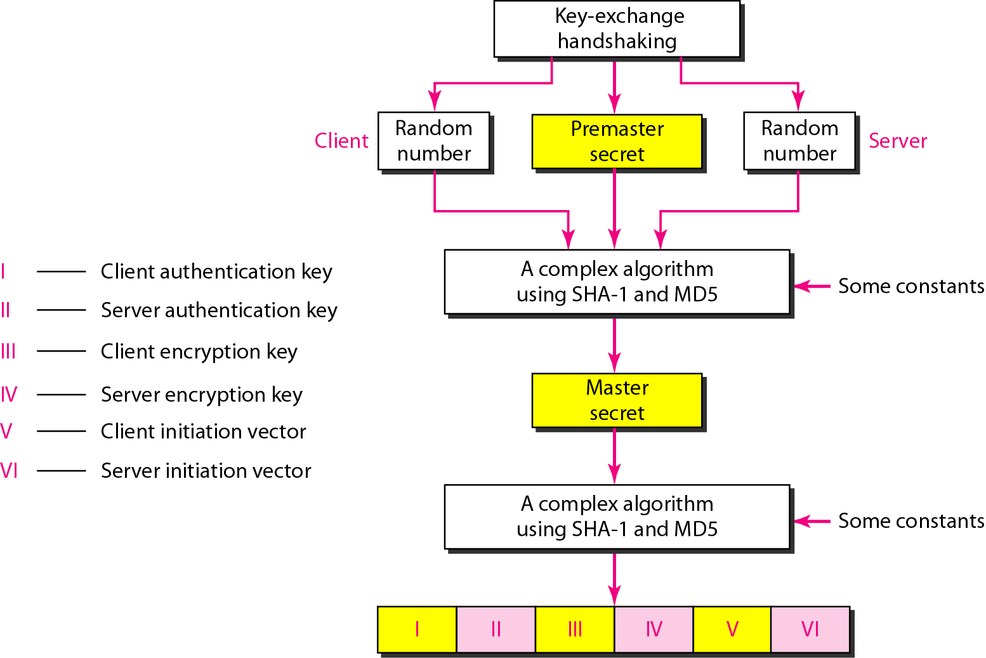
Creation of cryptographic secrets in SSL

Slide 13
Creation of cryptographic secrets in SSL
The process:
The client and server exchange two random numbers; one is created by the client and the other by the server.
The client and server exchange one premaster secret by using one of the key exchange algorithms.
48-byte master secret is created from the premaster secret by applying two hash functions (SHA-l and MD5).
The master secret is used to create variable-length secrets by applying the same set of hash functions and prepending with different constants.

Slide 14
Session and Connection
TCP is connection-oriented protocol.
The designers of SSL decided that they needed two-levels of connectivity session and connection:
  A session between two systems is an association that can last for a long time.
  A connection can be established and broken several
    times during a session.
Some of the security parameters are created during the session establishment and are in effect until the session is terminated (e.g. cipher suite and master key).
Some of the security parameters must be recreated foreach connection (e.g. six secrets).

Slide 15
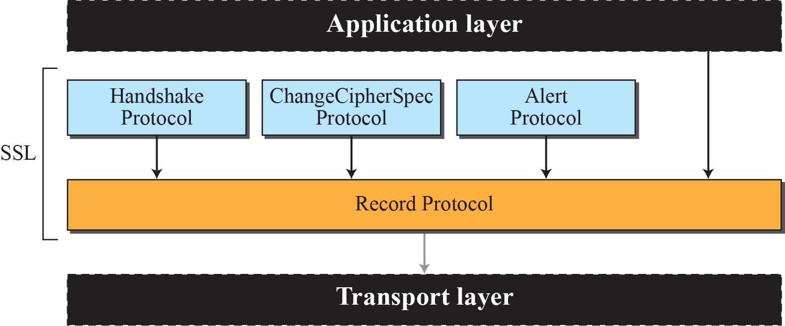
four protocols
SSL defines four protocols in two layers,

Slide 16
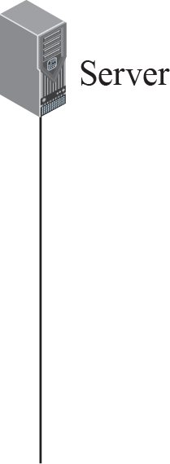
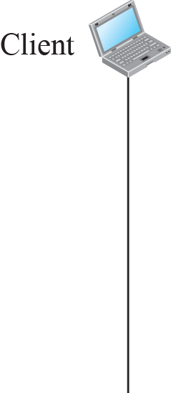




Handshake Protocol

Slide 17
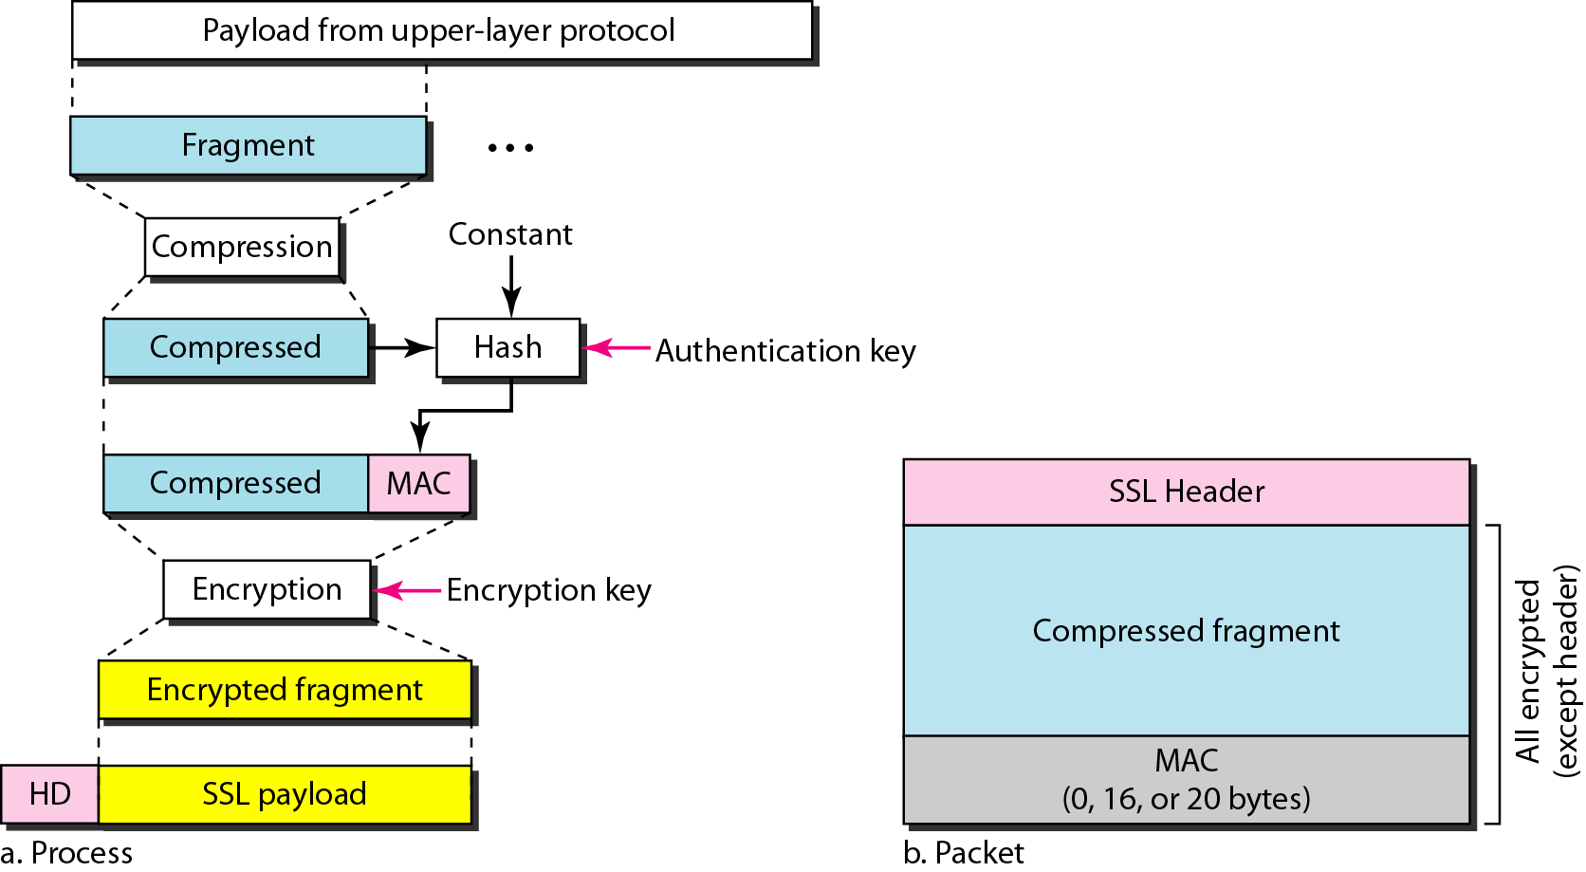
Processing done by the Record Protocol

Slide 18
Transport Layer Protocol (TLS)
Transport Layer Protocol (TLS) is the IETF standard version of SSL. The two are very similar with slight differences:
Version: SSL v3.0 compatible with TLS v1.0
Cipher Suite: TLS cipher suite doesn’t support Fortezza(key exchange algorithm).
Cryptographic secrets: TLS uses a pesudorandom function(PRF) to create the master key and the key materials.
Alert Protocol: TLS detects some alert messages and adds some new ones.
Handshake Protocol: the details of some messages have been changed in TLS.
Record Protocol: Instead of using MAC. TLS uses the HMAC.

Slide 19
Email Security

Slide 20
Email Security
Email is one of the most widely used and regarded network services.
Currently message contents are not secure.
  My be inspected either in transit,
  Or by suitably privileged users on destination system.

Slide 21
Email security enhancement
Confidentiality
protection from disclosure
Authentication
of sender of message
Message integrity
protection from modification
Non-repudiation of origin
protection from denial by sender

Slide 22
PGP
Pretty Good Privacy (PGP) is a protocol that provides security at application layer.
PGP is designed to create authenticated and confidential e-mail.
Widely used to secure emails.
Developed by Phil Zimmermann.
Selected best available crypto algorithms to use.
Integrated into a single program.
Available on Unix, PC, Macintosh, … systems.
Originally free, now have commercial versions available also.

Slide 23
PGP
Sending an e-mail is a one-time activity.
In e-mail, there is no session.
Alice sends a message to Bob; sometimes later, Bob reads the message and may or may not send a reply.
Unidirectional message➔ what Alice send to Bob is totally independent of what Bob sends to Alice.

Slide 24
Security Parameters
Since there is no session and no hand shaking, how can Alice and Bob agree on security parameters?
Phil Zimmerman has found a very elegant solution way for this problem➔ the security parameters need to be sent with the message.

Slide 25
PGP Services
Plaintext: no service, simplest
Message Authentication: Alice create a digest of the message and sign it with her private key. Bob verify the message using Alice's public key
Compression: compress the message and the digest.
Confidentiality with One-Time Session Key: Alice encrypts the message and the digest, and send the key itself with the message.
Code Conversion: PGP uses Radix 64 conversion. After the encryption, each character is converted to Radix 64 code.
Segmentation: PGP allows segmentation of the message after the message has been converted to Radix 64.

Slide 26
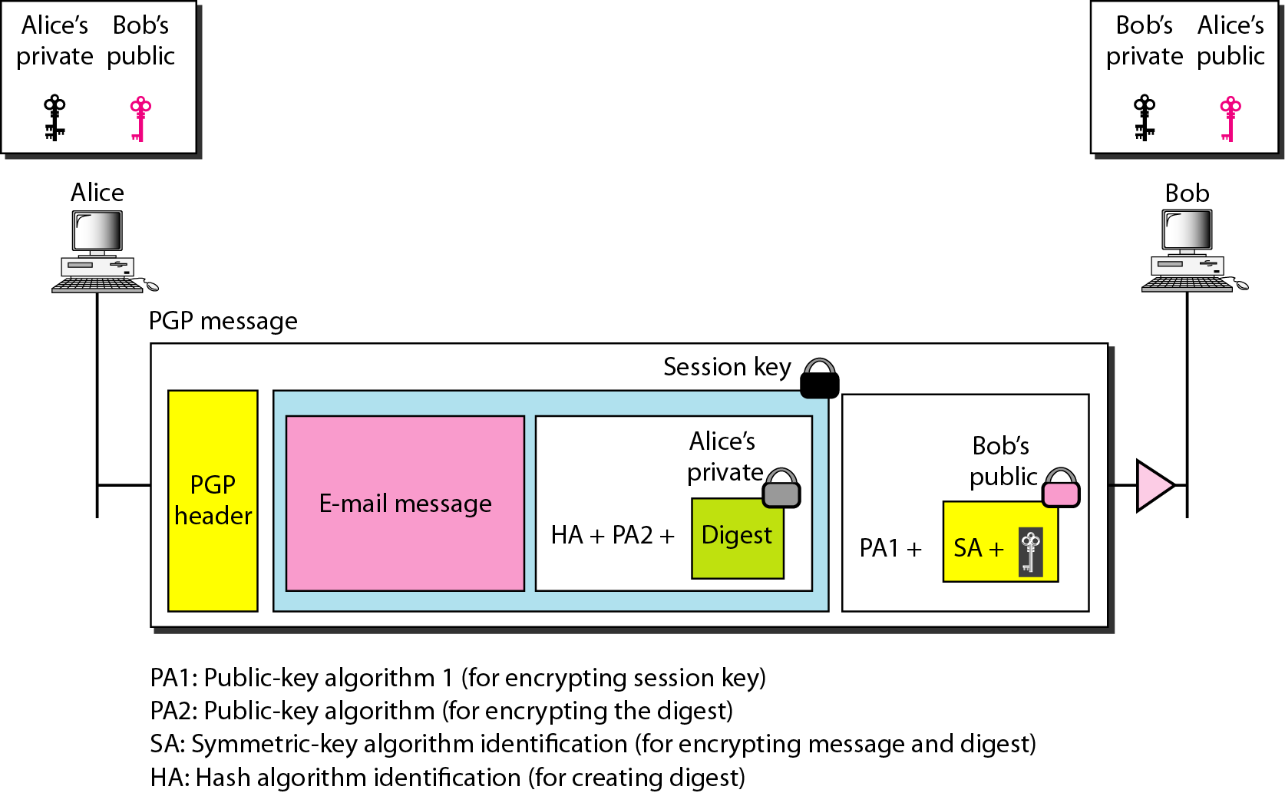
A scenario in which an e-mail message is authenticated and encrypted, assuming Alice and Bob trust each other

Slide 27
Sender Site (Alice)
1. Alice creates a session key (for symmetric encryption/decryption) and concatenates it with the identity of the algorithm which will use this key. The result is encrypted with Bob's public key. Alice adds the identification of the public-key algorithm
used above to the encrypted result.
a. Alice authenticates the message (e-mail) by using a public-key signature algorithm and encrypts it with her private key➔ signature. Alice appends the identification of the public key (used for encryption) as well as the identification of the hash algorithm (used for authentication) to the signature.
  b. Alice concatenates the three pieces of information created above with the message (e-mail) and encrypts the whole thing, using the session key created in step 1.
3. Alice combines the results of steps 1 and 2 and sends them to Bob (after adding the appropriate PGP header).

Slide 28
Receiver Site (Bob)
1. Bob uses his private key to decrypt the combination of the session key and symmetric-key algorithm identification.
2. Bob uses the session key and the algorithm obtained in step 1 to decrypt the rest of the PGP message. Bob now has the content of the message, the identification of the public algorithm used for creating and encrypting the signature, and the identification of the hash algorithm used to create the hash out of the message.
3. Bob uses Alice's public key and the algorithm defined by PA2 to decrypt the digest.
4. Bob uses the hash algorithm defined by HA to create a hash out of message he obtained in step 2.
5. Bob compares the hash created in step 4 and the hash he decrypted in step 3. If the two are identical, he accepts the message; otherwise, he discards the message.

Slide 29
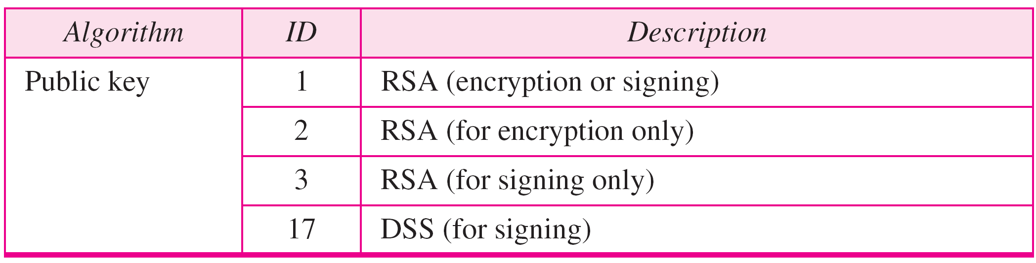
PGP Algorithms

Slide 30
PGP operations: compression
By default PGP compresses message after signing but before encrypting.
Can store uncompressed message and signature for later verification.
Uses ZIP compression algorithm.

Slide 31
PGP operations: compatibility
Encrypted messages and signatures may contain arbitrary octets.
Email was designed only for text.
Hence PGP must encode raw binary data into printable ASCII characters.
Uses radix-64 algorithm
  –maps 3 bytes to 4 printable chars
  –also appends a CRC
PGP also segments messages if it is too big.

Slide 32
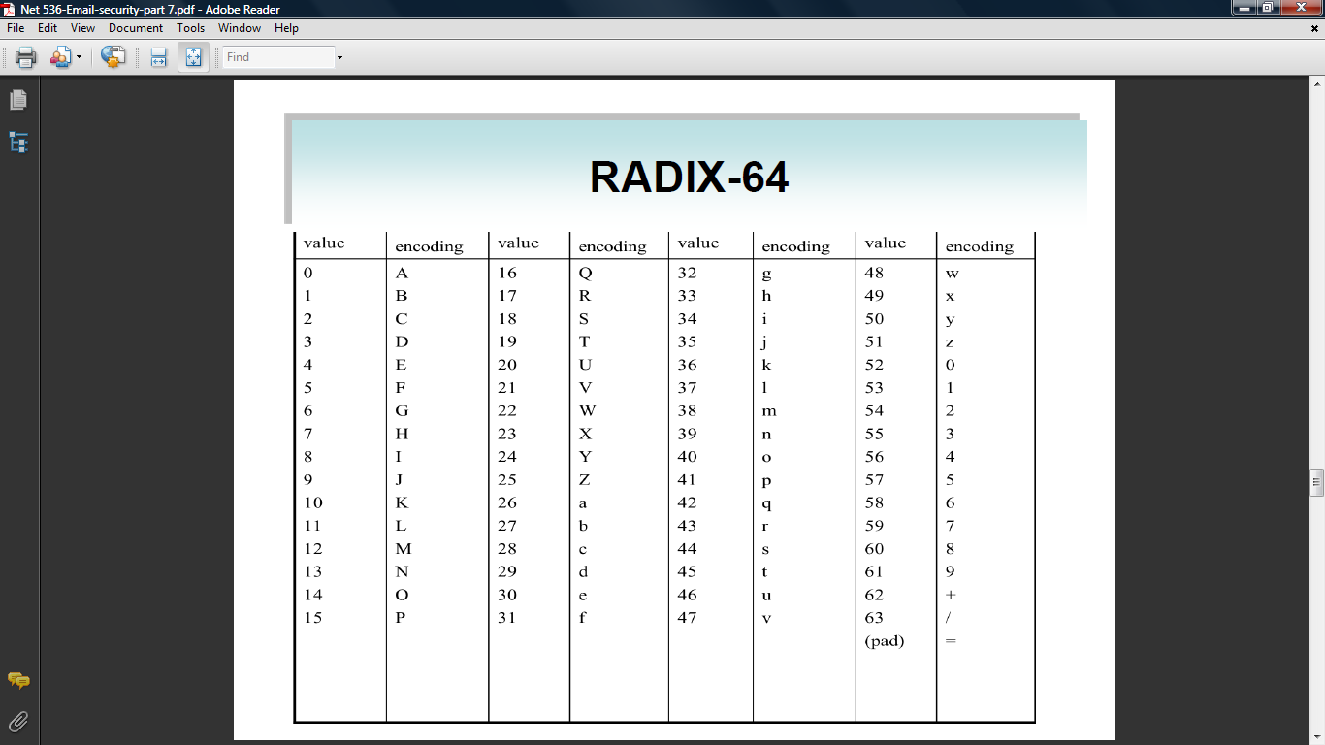
RADIX 64

Slide 33
Key Rings
What if Alice needs to send messages to many people?
Thus, Alice needs a key ring of public keys, with a key belonging to each person with whom Alice needs to Correspond (send or receive messages)
PGP provides a ring of private/public keys for tow reasons:
  Alice may change her pair of keys.
  Alice may need to correspond with different groups of people ( friend, colleagues, and so on).

Slide 34
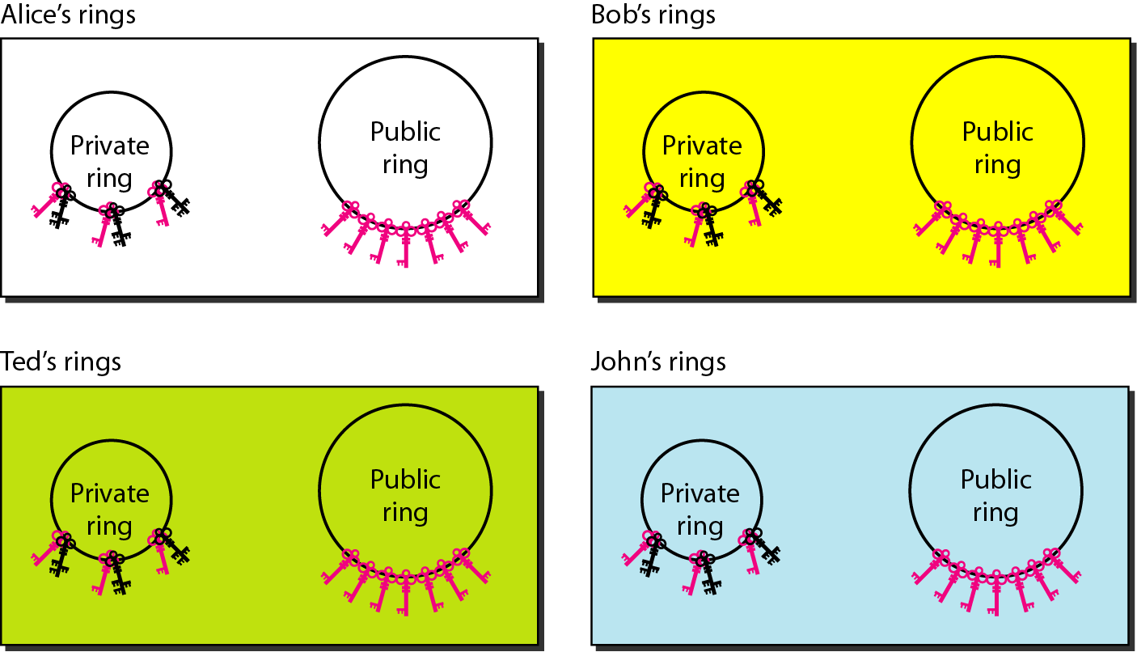
Key Rings

Slide 35
Key Rings
Alice has several pairs of private/public keys belonging to her and public keys belonging to other people. Note that everyone can have more than one public key. Two cases may arise.
1. Alice needs to send a message to one of the persons in the community.
      a. She uses her private key to sign the digest.
      b. She uses the receiver's public key to encrypt a newly created session key.
      c. She encrypts the message and the digest with the created session key.
2. Alice receives a message from one of the persons in the community.
    a. She uses her private key to decrypt the session key.
    b. She uses the session key to decrypt the message and digest.
    c. She uses the receiver’s public key to verify the digest.

Slide 36
PGP Certificate
In PGP, there is no need for CAs; any one in the ring can sign a certificate for anyone else in the ring ➔ Forms a “web of trust”.
In PGP, the certificate issuer is called an introducer.
Users can revoke their keys.

Slide 37
S/MIME
Security enhancement to MIME (Multipurpose Internet Mail Extensions) email
  original Internet RFC822 email was text only
  MIME provided support for varying content types and multi-part messages.
  with encoding of binary data to textual form.
  S/MIME added security enhancements.
Have S/MIME support in various modern mail agents: MS Outlook, Netscape etc

Slide 38
S/MIME functions
Enveloped data
  encrypted content and associated keys
Signed data
  A digital signature is formed by signing the message digest and then encrypting that with the signer private key.
Clear-signed data
a digital signature of the content is formed, However only the signature is encoded.

Slide 39
S/MIME cryptographic algorithms
Hash functions: SHA-1 & MD5
Digital signatures: DSS & RSA
Session key encryption: ElGamal & RSA
Message encryption: Triple-DES, RC2/40 and others
Have a procedure to decide which algorithms to use.

Slide 40
S/MIME certificate processing
S/MIME uses X.509 v3 certificates
Managed using a hybrid of a strict X.509 CA hierarchy & PGP’s web of trust
Each client has a list of trusted CA’s certs and own public/private key pairs & certs
Certificates must be signed by trusted CA’s.

