Slide 1
NET 536
Network Security
Lecture 6: DNS Security

Slide 2
Outline
Part I: DNS
    Overview of DNS
    DNS Components
    DNS Transactions
    Attack on DNS
Part II: DNS Security DNSSEC
    DNSSEC Objective
    DNSSEC Scope
    DNSSEC Resource Records
    How DNSSEC works ?
Reference: http://compsec101.antibozo.net/papers/dnssec/dnssec.html

Slide 3
Part I: DNS

Slide 4
Introduction
The DNS provides a mechanism that resolves Internet host names into IP addresses and vise versa.
The DNS also supports other Internet directory-like lookup capabilities to retrieve information relating to DNS Name Servers, Canonical Names* , Mail Exchangers, etc.
Many security weaknesses surround IP and the protocols carried by IP & The DNS is not immune to these security weaknesses.
Lack authenticity and integrity checking of the data held within the DNS make it not secure.
* Canonical name (CNAME) is a record in the DNS database that indicates the true host name of a computer associated with its aliases.

Slide 5
Overview of DNS
DNS provides Internet lookup that maps the names of computer systems to their respective numerical IP network addresses.
The DNS not only supports host name to network address resolution, known as forward resolution, but it also supports network address to host name resolution, known as inverse resolution.
Without it, the only way to reach other computers on the Internet is to use the numerical network address.
forward
inverse

Slide 6
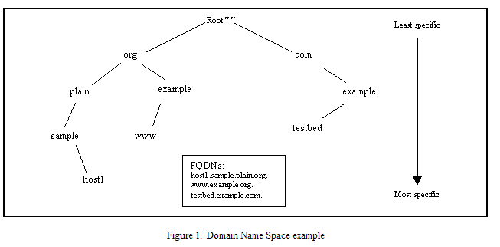
The Domain Name Space

Slide 7
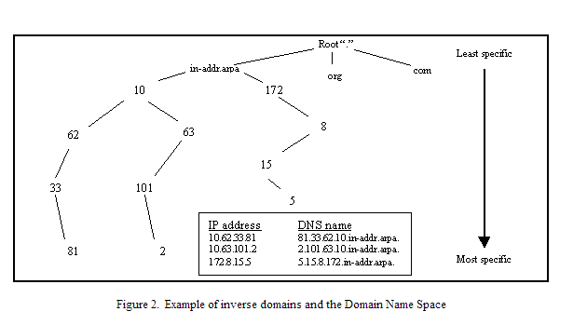
The Inverse Domain Name Space
When the DNS is used to map an IP address back into a host name (inverse resolution), the DNS makes use of the same notion of labels from left to right (most specific to least specific) when writing the IP address. This is in contrast to the typical representation of an IP address whose dotted decimal notation from left to right is least specific to most specific. To handle this, IP addresses in the DNS are typically represented in reverse order. IP addresses fall under a special DNS top level domain (TLD), known as the in-addr.arpa domain. By doing this, using IP addresses to find DNS host names are handled just like DNS host name lookups to find IP addresses

Slide 8
DNS Component
Major Components:
  Database: DNS tree and Resource Records.
  Name Servers: Authoritative for one or more zones – Answers queries.
  Clients: Software library, called resolver, sends queries to name servers.
Resource Records (RRs):
  Address (A) [Maps Host name into an IP address]
    www.abc.com. A 10.1.0.52
  Pointer (PTR) [Maps an IP address into hostname]
    52.0.1.10.IN-ADDR.ARPA. PTR www.abc.com.

Slide 9
DNS Transaction
Name Server (NS) [Denotes a name server for a zone]
    www2.abc.com. NS dns.www.abc.com.
Canonical Name (CNAME) [Defines an alias name and maps it to the absolute (canonical) name]
abc.com. CNAME www.abc.com
Two most common transactions
    DNS zone transfers: the secondary server retrieves a new copy of the zone , if the primary server has a more recent version.
    DNS queries/responses: A DNS query is answered by a DNS response.

Slide 10
Attack on DNS
DNS Cache Poisoning
DNS ID Spoofing
Client Flooding
DNS Dynamic Update Vulnerabilities
Information Leakage
Compromise of DNS server’s authoritative data

Slide 11
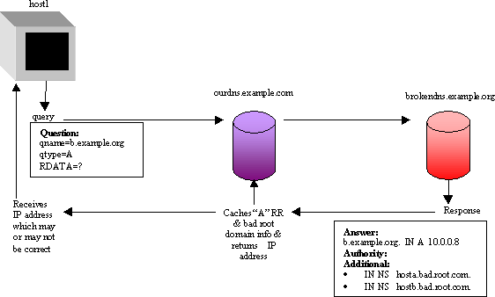
DNS Cache Poisoning
DNS Cache Poisoning
    DNS A receives a query that it does not have an answer to, so it asks DNS B.
    DNS B replies with wrong information
    DNS A accepts the response of DNS B without performing

Slide 12
DNS Cache Poisoning Attack
An attacker use his rogue name server and intentionally formulating misleading information.
This bogus information is sent as either the answer or as just a helpful hint and gets cached by the unsuspecting DNS server.
One way to coerce a susceptible server into obtaining the false information is for the attacker to send a query to a remote DNS server requesting information pertaining to a DNS zone for which the attacker’s DNS server is authoritative.
Having cached this information, the remote DNS server is likely to misdirect legitimate clients it serves .

Slide 13
DNS Cache Poisoning Attack
Attack Objective : Denial of service.
  Negative response could be a message that the requested name could not be resolved ( while it can be) so that the client can't get the website he wants
  Negative response could be incorrect resolved name that direct the user to a website he doesn’t need.

Slide 14
Client Flooding
Client sends a DNS query.
Attacker send thousands of responses made to appear as if originating from the DNS server.
Client accepts responses because it lacks the capability to verify the response origin.

Slide 15
DNS Dynamic Update Vulnerabilities
DNS Dynamic Update Vulnerabilities
  An attacker using IP spoofing of a trusted server may launch a DoS attack by deleting RRs, or malicious redirection by changing an IP of a RR in an update.

Slide 16
Attacks Information Leakage
Attacks Information Leakage
  Zone transfers can leak information concerning internal networks
  Or an attacker can query one by one every IP address in a domain space to learn unassigned IP addresses.

Slide 17
Compromise of DNS server’s authoritative data
Compromise of DNS server’s authoritative data
  DNS server has some vulnerabilities not related to DNS.
  Attacker gets administrative privileges on DNS Server.
  Attacker modifies zone information for which the DSN server is authoritative.

Slide 18
Part II: DNS Security DNSSEC

Slide 19
Introduction
DNSSEC is a security extensions to the DNS protocol in response to the security issues surrounding the DNS.
a new set of RRs are defined to hold the security information that provides strong security to DNS zones wishing to implement DNSSEC.
These new RR types are used in conjunction with existing types of RRs.
This allows answers to queries for DNS security information belonging to a zone that is protected by DNSSEC to be supported through non-security aware DNS servers.

Slide 20
DNSSEC Objective
To assure authentication and integrity to DNS services.
However: DNSSEC doesn’t provide access control and confidentiality services
Authentication and integrity of information held within DNS zones is provided by using digital signature.
Although DNSSEC doesn't provide confidentiality to DNS transactions, it supports confidentiality as a worldwide public key distribution mechanism.

Slide 21
DNSSEC Scope
DNSSEC provides three services:
  key distribution
  data origin authentication
  transaction and request authentication.

Slide 22
DNSSEC Scope : Key Distribution
The retrieval of the public key of a DNS name to verify the authenticity of the DNS zone data.
Provides a mechanism through which any key associated with a DNS name can be used for purposes other than DNS.
The public key distribution service supports several different types of keys and several different types of key algorithms.

Slide 23
DNSSEC Scope : Data Origin Authentication
Data origin authentication is the core of the design of DNSSEC.
It mitigates such threats as cache poisoning and zone data compromise on a DNS server.
The RRSets within a zone are signed to assert to resolvers and servers that the data just received can be trusted.
The digital signature contains the encrypted hash of the RRSet.
The hash is signed using a private key usually belonging to the corresponding zone.
The recipient of the RRSet can then check the digital signature against the data in the RRSet just received.

Slide 24
DNSSEC Scope :DNS Transaction and Request Authentication
Service 1: It provides the ability to authenticate DNS requests and DNS message headers.
This guarantees that :
  the answer is in response to the original query
  the response came from the server for which the query was intended.
To assure this
Part of the information, returned in a response to a query from a security aware server, is a signature.
This signature is produced from the concatenation of the query and the response.
This allows a security aware resolver to perform any necessary verification concerning the transaction.

Slide 25
DNSSEC Scope :DNS Transaction and Request Authentication
Service 2 : DNS Dynamic Updates.
Without DNSSEC
  DNS Dynamic Update does not provide a mechanism that stop any system with access to a DNS authoritative server from updating zone information.
With DNSSEC
  Secure DNS Dynamic provides strong authentication for systems allowed to dynamically manipulate DNS zone information on the primary server

Slide 26
DNSSEC Resource Records
Introduces new RR types:
  KEY: used for storing a public key that is associated with a DNS name.
  SIG: Digital signature. The SIG RR provides authentication for a RRSet and the signature’s validity time.

Slide 27
DNSSEC Resource Records
Introduces new RR types:
NXT:
NXT RRs are used to indicate a range of DNS names that are unavailable or
a range of RR types that are unavailable for an existing DNS name.
WHY ?
  The DNS provides the ability to cache negative responses.
  A negative response means that a corresponding RRSet does not exist for the query.
  DNSSEC provides signatures for these nonexistent RRSets so that their nonexistence in a zone can be authenticated.

Slide 28
How DNSSEC works
Each RRSet has an associated SIG RR which is a digital signature of the RRSet using the private key of the zone.
If a security aware resolver reliably learns a public key of the zone, it can authenticate signed data read from that zone.
A security aware server will attempt to return, with RRs retrieved, the corresponding SIGs.

Slide 29
Example of DNS Server …

Slide 30
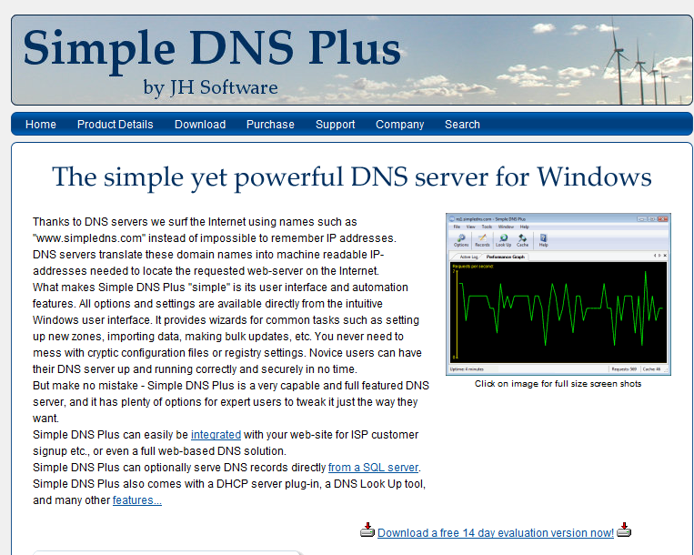
DNS Server
Downloading DNS server software called Simple DNS plus as it shown below http://www.simpledns.com/
Click here to download

Slide 31
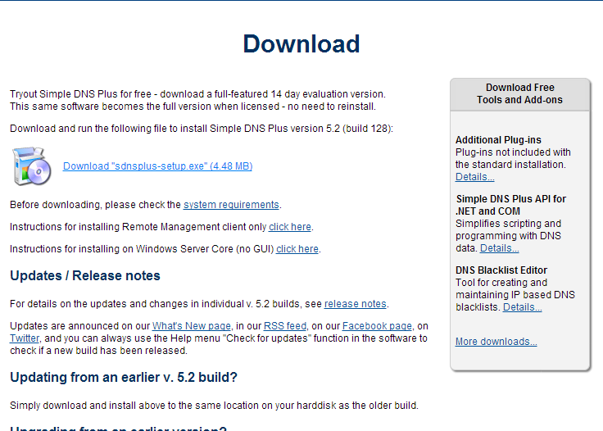
Simple DNS plus
Trial version

Slide 32
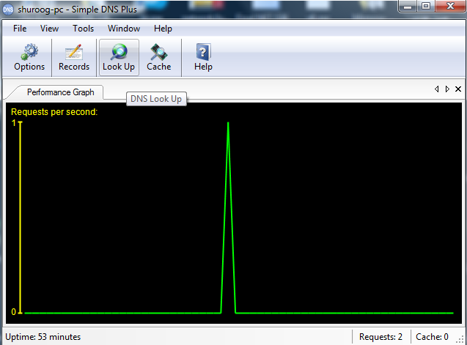
Simple DNS plus
Once the download is completed, open the software and you will see:
Look up option

Slide 33
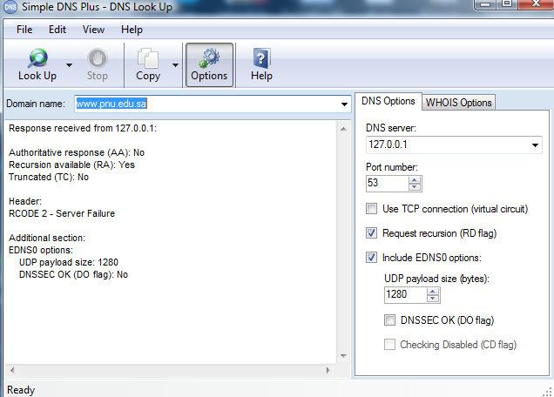
Simple DNS plus
After using the "look up" service of the software to retrieve the RR record of www.pnu.edu.sa,
2. Click look up
1. Put the URL
3. RR report

