Slide 1
NET 536
Network Security
Lecture 4: Firewalls

Slide 2
lecture contents:
Introduction
Goals for a firewall
Techniques that used by Firewalls
Types of Firewalls

Slide 3
Introduction
Internet connectivity is no longer optional for organization.
Using the Internet may create a threat to the organization.
One solution is to equip each workstation and server on the premises network with strong security features e.g. intrusion protection. However, this is cost a lot when an organization has a thousands of system running on different OS.
Thus, Firewall is inserted between the premises and Internet to establish a controlled link and to erect an outer security wall.

Slide 4
Goals for a firewall
All traffic from inside to outside, and vice versa, must pass through the firewall.
Only authorized traffic, as defined by the local security policy, will be allowed to pass.
The firewall itself is immune to penetration.

Slide 5
Techniques that used by Firewalls
Service Control: Determine the types of Internet services that can be accessed, inbound or outbound. The Firewalls may filter traffic based on IP address, protocol, or port number.
Direction Control: Determined the direction in which particular requests may be initiated and allowed to flow through the firewall.
User Control: Controls access to a service according to which user is attempting to access it. This includes local user and external user.
Behavior Control: Controls how a particular services are used e.g. firewall may filter e-mail to eliminate spam.

Slide 6
Types of Firewalls
Packet Filtering Firewalls
Stateful Inspection Firewalls
Application-Level Gateway
Circuit-Level Gateway

Slide 7
Packet Filtering Firewalls
A packet filtering firewall applies a set of rules to each incoming and outgoing IP packet and then forward or discards the packet.
Filtering rules are based on information contained in a network packet:
    Source IP address: the IP address of the system that originate the IP packet (e.g. 192.178.1)
    Destination IP address: the IP address of the system the IP packet is trying to reach (e.g. 192.168.1.2)
    Source and destination transport-level address: the transport-level ( e.g. TCP or UDP) port number, which defines applications such as TELNET.
    IP protocol field: Defines the transport protocol.
    Interface: For a firewall with three or more ports, it defines which interface of the firewall the packet is destined for.

Slide 8
Packet Filtering Firewalls
The packet filter is typically set up as a list of rules based on matches to fields on the IP or TCP header.
If there is a match to one of the rules, that rules is invoked to determine whether to forward or discard the packet.
If there is no match to any rule, then a default action is taken.
Two default policies are possible:
  Default = discard : that which is not expressly permitted is prohibited. ( more conservative) used by government organizations and businesses.
  Default = forward: that which is not expressly prohibited is permitted. ( more open) used by universities.

Slide 9
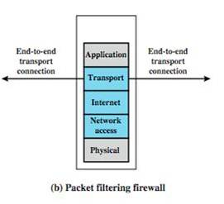
Packet Filtering Firewalls

Slide 10

Packet Filtering Firewalls Examples
Default= discard is implemented as follow:

Slide 11

Packet Filtering Firewalls Examples
Example 1:
Suppose we want to allow inbound mail (SMTP, port 25) but only to our gateway machine. Also, suppose that mail from some particular site SPIGOT is to be blocked.
Solution1:

Slide 12

Packet Filtering Firewalls Examples
Example 2:
Now suppose that we want to implement the policy “any inside host can send mail to the outside”.
Solution 2:

Slide 13
Packet Filtering Firewalls Examples
Solution 2 allows calls to come from any port on an inside machine, and will direct them to
port 25 on the outside. Simple enough…
So why is it wrong?

Slide 14
Packet Filtering Firewalls Examples
Our defined restriction is based only on the outside host’s port number, which we have no way of controlling.
Now an attacker can access any internal machines and port by originating his call from port 25 on the outside machine.
What can be a better solution ?

Slide 15
Packet Filtering Firewalls Examples
The ACK signifies that the packet is part of an ongoing conversation.
Packets without the ACK are connection establishment messages, which we are only permitting from internal hosts

Slide 16
Packet Filtering Firewalls
Advantages
  The simplicity of filtering packets.
  Packet filters are transparent to users ➔ no need any configuration or extra software to be added.
  Very fast.
Disadvantages
  Due to the lack of upper-layer functionality, packet filtering cannot provide the following:
    prevent attacks that employ application-specific functions.
    Support advanced user authentication.
  Limited information available to the firewall➔ limited functionality.
  Due to the small number of variables used in access control decisions, packet filter firewalls are subject to security breaches.

Slide 17
Port Numbering
TCP connection
  Server port is number less than 1024
  Client port is number between 1024 and 65535
Permanent assignment
  Ports <1024 assigned permanently
    20,21 for FTP 23 for Telnet
    25 for server SMTP 80 for HTTP
Variable use
  Ports >1024 must be available for client to make any connection
  This presents a limitation for stateless packet filtering
    If client wants to use port 2048, firewall must allow incoming traffic on this port
  Better: Stateful filtering knows outgoing requests

Slide 18
Port Numbering
Example:
The Simple Mail Transfer Protocol (SMTP) where e-mail is transmitted from a client system to a server system. The SMTP operates by setting up a TCP connection between client and server in which the TCP server port number, in this example SMTP, is 25. The TCP port number for the SMTP client is a number between 1024 and 65535.

Slide 19
Stateful Inspection Firewalls
The traditional packet filtering makes filtering decision on an individual packet basis and doesn’t take into consideration any higher-layer context.
In general, when an application uses TCP creates a session with a remote host, it creates a TCP connection where the port number for the remote (sever) application is a number less than 1024 and TCP port number for the local (client) application is a number between 1024 and 65535.
This lead to have a new type of firewall that called Stateful Inspection Firewalls which also knowns as Dynamic packet firewalls.

Slide 20
Stateful Inspection Firewalls
A Stateful Inspection Firewall reviews the same packet information as a packet filtering firewall, but it also keeps track of the state of connection.
It dynamically keeping track of whether a session is being initiated or currently transmitting data or being closed.
It adds a level of security by “understating” the content of packets and the session.
Some Stateful Inspection Firewalls keep track of TCP sequence numbers to prevent attacks that depends on the sequence number such as session hijacking.

Slide 21
Stateful Inspection Vs Packet filtering Firewalls
Traditional packet filters do not examine higher layer context
    ie matching return packets with outgoing flow
Stateful inspection filters address this need
They examine each IP packet in context
    Keep track of client-server sessions
    Check each packet validly belongs to one
Hence are better able to detect bogus packets out of context
Notes:
A traditional packet filter makes filtering decisions on an individual packet basis and does not take into consideration any higher layer context. A stateful inspection packet filter tightens up the rules for TCP traffic by creating a directory of outbound TCP connections, and will allow incoming traffic to high-numbered ports only for those packets that fit the profile of one of the entries in this directory. Hence they are better able to detect bogus packets sent out of context.

Slide 22
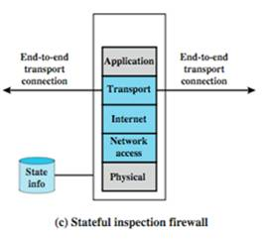
Stateful Inspection Firewalls

Slide 23
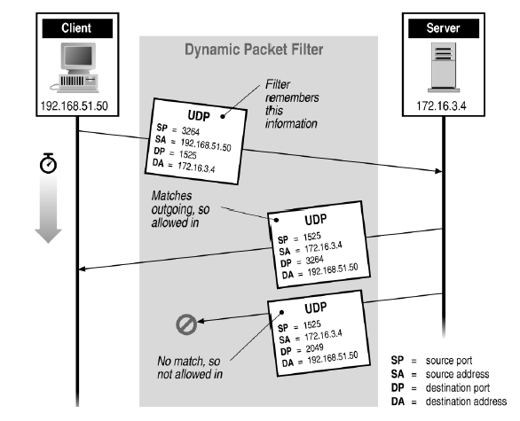
Stateful Inspection Firewalls

Slide 24
Stateful Inspection Firewalls
Stateful Inspection is more secure than packet filtering because it only allow packets belonging to an allowed session.
For example, instead of permitting any host or program to send any kind of TCP traffic on port 80, a stateful inspection firewall ensures that packets belong to an existing session.

Slide 25
Application-Level Gateway
An application-level gateway (application proxy) is implemented through a proxy server, which acts as an intermediary between a client and a server.
The user contacts the gateway asks the user for the name of the remote host to be accessed.
When the user responds and provides a valid user ID and authentication information, the gateway contacts the proxy server.
If the gateway doesn’t implement the proxy code for a specific application, the service is not supported and cannot be forwarded across the firewall.
NOTE: The originating client and the remote server are hidden from each other.

Slide 26
Application-Level Gateway
Application level gateways typically provide proxy services for email, Telnet and the World Wide Web.
Advantage:
  An application-level gateway is more secured than packet filtering.
Drawback:
  The additional processing overhead on each connection.

Slide 27
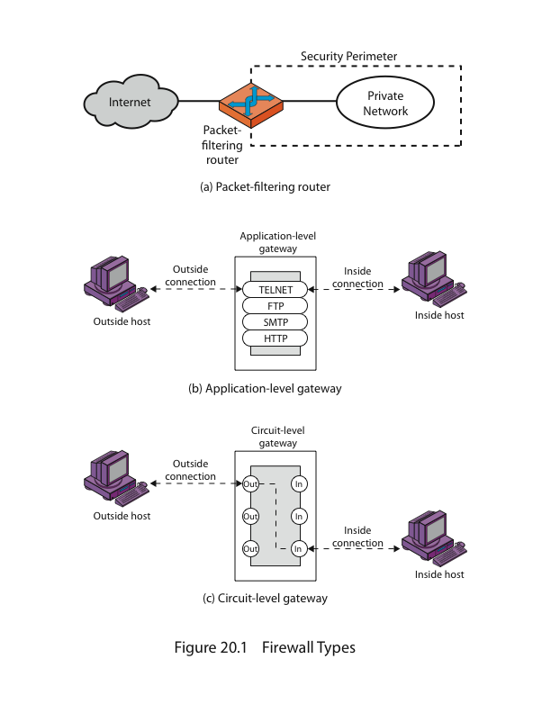
Application-Level Gateway

Slide 28
Circuit-Level Gateway
A circuit level gateway acts as a proxy and has the same advantage as an application level gateway in hiding the internal host from the serving host, but it includes less processing than an application level gateway.
Circuit level gateways can be implemented within application level gateways or as stand-alone systems.
Implementation within an application level for example with a circuit level gateway in one direction and an application level gateway in the other.
Example, if the administrator trusts the internal users, the gateway can be configured to support application-level on inbound connection and circuit-level functions for the outbound connection.
Disadvantages of circuit level gateways is the absence of content filtering

Slide 29
Circuit-Level Gateway

Slide 30
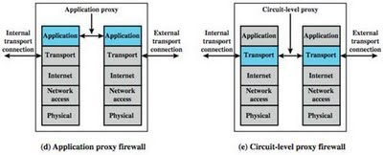
Application-level and Circuit-level firewall

Slide 31
Bastion Host
Bastion Host is a system identified by the firewall administrator as a critical strong point in the network’s security (highly secure host system ).
Typically, bastion host serves as a platform for an application-level or circuit-level gateway.
For instance, a bastion host will run a secure version of the operating system, and may allow only essential services to be installed with a restricted set of Telnet, DNS, FTP and SMTP protocols.

Slide 32
Host-Based Firewalls
A host-based firewall is a software module used to secure an individual host.
It filters and restrict the flow of packets.
A common location for such firewalls is a server because:
  Filtering rules can be tailored to the host environment.
  Both internal and external attack must pass through the firewall.

Slide 33
Personal Firewall
A personal firewall controls the traffic between a personal computer or workstation on one side and the Internet on the other side.
In a home environment with multiple computers connected to the Internet, firewall functionality can also be housed in a router that connects all of the home computers to a DSL, cable modem, or other Internet Interface.
Personal Firewall is much less complex than either server-based firewalls or stand-alone firewall.
The primary role of the personal firewall is to deny unauthorized remote access to the computer

Slide 34
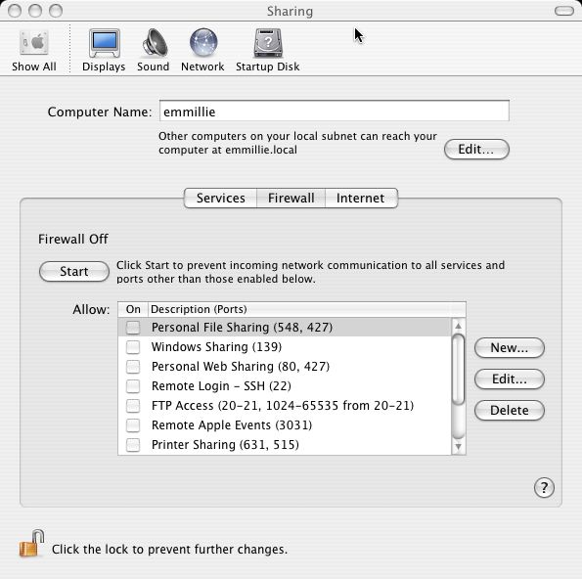
Personal Firewall Example MAC OS X
It defined the port
numbers that accepted

Slide 35
Distributed Firewall
With distributed firewall, it needs to establish both internal and external DMZ.
An important aspect of a distributed firewall configuration is security monitoring include:
  log aggregation and analysis
  firewall statistics
  fine-grained remote monitoring of individual hosts if needed.

Slide 36
Distributed Firewall
A distributed firewall configuration involves standalone firewall devices plus host-based firewalls, personal firewall working together under a central administrative control.
Administrators can configure host-resident firewalls on hundreds of servers and workstation as well as configuring personal firewalls on local and remote user systems. Tools let the network administrator set policies and monitor security across the entire network.

Slide 37
DMZ Network
DMZ (Demilitarized Zone) network is located between the external firewall and the internal firewall.

Slide 38
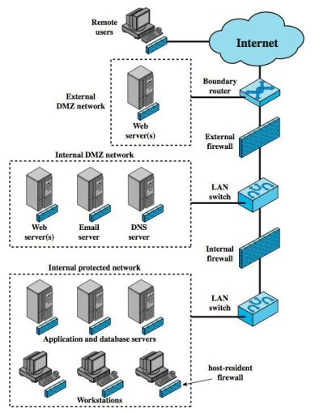
Distributed Firewall

