Slide 1
NET 536
Network Security
Lecture 2: Overview of TCP/IP protocol

Slide 2
lecture contents:
Overview of TCP/IP protocol:
  TCP/IP architectural models
  TCP protocol layers.

Slide 3
TPC/IP Review
Ideally, a secure network architecture is designed before any systems are in place.
TPC/IP review:
Internet is made up of a wide variety of computers, from supercomputers to personal computers. Each of these computers has its type of software and application running. How do all of these computers understand each other and work together ?
There are a set of rules to govern communications so each computer understand how to act and how to interpret the actions of the other computers.

Slide 4
  TCP/IP architectural models
TCP/IP is a hierarchical protocol made up of interactive modules, each of which provides a specific functionality.
The layers of the TCP/IP protocol suite contain relatively independent protocols.
The term hierarchical means that each upper-level protocol is supported by one or more lower-level protocols.

Slide 5
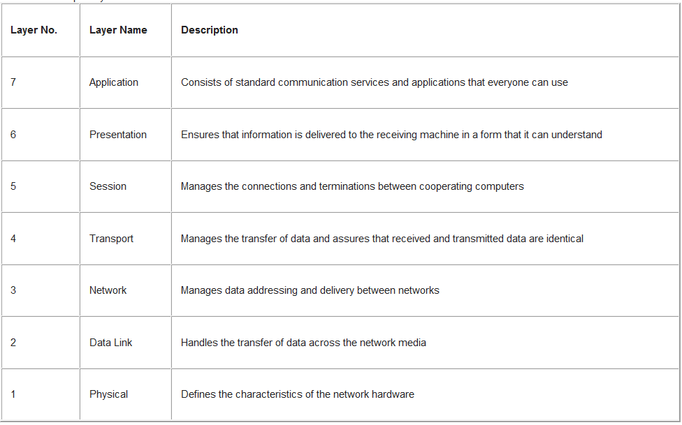
OSI models

Slide 6
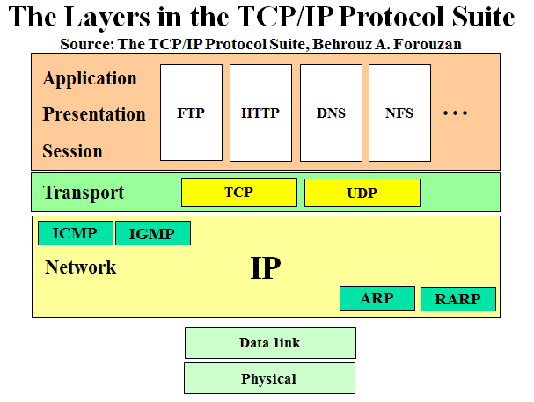
TCP/IP Architectural Models

Slide 7
TCP protocol layers
Physical Layer
  The physical network layer specifies the characteristics of the hardware to be used for the network.
  For example, it specifies the physical characteristics of the communications media
Data Link Layer
  The data-link layer identifies the network protocol type of the packet, in this case TCP/IP.
  It also provides error control and "framing."
No specific protocol is defined at this layer, rather, TCP/IP model supports all the standard and proprietary protocols.

Slide 8
TCP protocol layers
Network layer (internetwork layer)
  TCP/IP at this layer supports the Internetworking Protocol (IP)
  There are also some other protocols that support data movement in this layer. Including: ARP, RARP, ICMP, and IGMP.

Slide 9
TCP protocol layers:
Protocols at the network layer
Internetworking Protocol (IP)
  Most important protocol of the TCP/IP network stack!
  Implements internetworking.
  IP is an unreliable and connectionless protocol- a best-effort delivery.
  It is host-to-host protocol.

Slide 10
TCP protocol layers:
Protocols at the network layer
Address Resolution Protocol (ARP)
  It is used to find the physical address (NIC) of the node after its Network address is known.
Reverse Address Resolution Protocol (RARP)
  It is used to find the Internet address of the node after its physical address is known.

Slide 11
TCP protocol layers:
Protocols at the network layer
Internet Control Message Protocol (ICMP)
  It is used by hosts and gateways to send notification of datagrams ( packets) problem back to the sender.
Internet Group Message Protocol (IGMP)
  It is used to facilitate the simultaneous transmission of messages to a group of recipients.

Slide 12
TCP protocol layers
Transport Layer
  In this layer, the protocol is responsible for delivery of message from a process to another process.

Slide 13
TCP protocol layers:
Protocols at the Transport layer
User Datagram Protocol (UDP)
It adds port addresses, checksum error control, and length information to the data from the upper layer.
Transmission Control Protocol (TCP)
It is reliable and connection-oriented.
Stream Control Transmission Protocol (STCP)
It supports the newer application e.g. voice over the Internet.
It combine best features of UDP and TCP.

Slide 14
TCP protocol layers
Application Layer
  The application layer in TCP/IP is equivalent to the combined session, presentation, and application.

Slide 15
TPC/IP Review
When transferring information across a network, TCP breaks information into small pieces (packets). Each packet is sent separately.
TCP has support to detect errors, and lost of data.
IP handles carrying TCP packets from one computer to the other one based on 4 bytes (destination IP address).
Each computer is uniquely identified by a specific IP address.
When a client requests a service from a server, it builds a TCP connection with the server.

Slide 16
TPC/IP Review
TCP connection includes :
  connection establishment
  Data exchange
  Connection termination
A port number is used to distinguish various services.
A Port is a way to identify a specific service on a computer in a network.

Slide 17
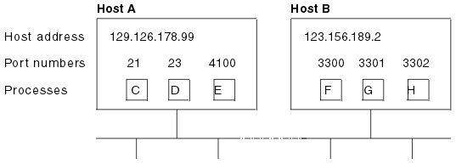
TPC/IP Review

Slide 18
TPC/IP Review
Port 80 is used by HTTP (send and retrieve web pages).
Port numbers are specified by a 16 bits and enumerated from 0 to 65535.
End to End communication can be identified by:
  IP address source,
  source Port,
  IP address destination,
  destination Port.
Basic connection: Client browser finds first an unused dynamic port)

Slide 19
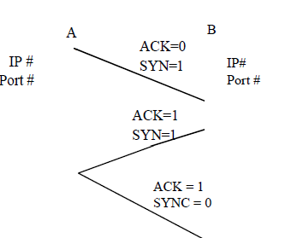
TPC/IP Review

Slide 20
TPC/IP Review
A client program A (IP 5.6.7.8) wants to open a connection with a server B (IP 1.2.3.4) for web service (on port 80).
A begins the connection attempt by dynamically openning a port, say 1078.
A sends 5.6.7.8: 1078 1.2.3.4: 80 Syn = 1.
B receives the packet and understands that A wants to
form a new connection.
B sends a response for A 1.2.3.4: 80 5.6.7.8: 1078 Syn= 1, ACK = 1
A informs B that the response has been received
5.6.7.8: 1078 1.2.3.4: 80 Syn =0

Slide 21
Security Principles
Security principles:
1- Least privilege:
States that a user should have only the privileges needed
to do his job. Least privilege is enforced using a
network device, such as a router with an access control
list (ACL) which tells a computer operating system
which access rights each user has to a particular object.
2- Layered security:
Is the concept that security functions should happen at
multiple layers.

Slide 22
Security Principles
Physical layer: traditional security measures such as cameras, walls are used to present unauthorized users.
Data link: unused port can be disabled. We can also rely on VPN.
Network layer: firewalls and ACLs restrict network access.
Intrusion detection may base its decision on TCP/UDP port numbers.(transport layer)
Proxies operate between the transport and the application layer.
Top layers are application content inspection services (anti-virus scanners,…).

Slide 23
Security Principles
3- Functional segmentation:
Is based on layered security and the principle of least privilege.
Functional segmentation suggests a design in which
the network is partitioned according to user or device function.
Each segment may be further divided by academic department.
Segmentation advantage is in preventing the spread of worms such as slammers.

Slide 24
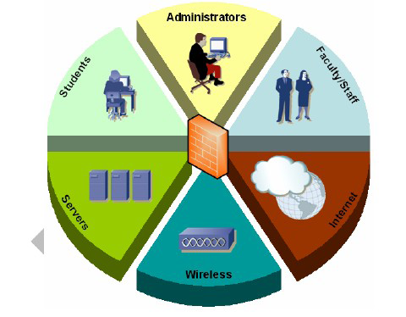
Security Principles

