Slide 1
NET 536
Network Security
Lecture 5: IPSec and VPN

Slide 2
lecture contents:
Introduction
IPSec Artechicture
IPSec Modes
AH vs ESP
Authentication Check Principles
VPN

Slide 3
Part 1: IPSec

Slide 4
Introduction
Internet was tiny and relatively private. Today it is enormous and truly public.
A number of methods have evolved over the years to address the need for security. Most of them are focused on the higher layers of the OSI model.
IPSec is not a single protocol. It is a set of services and protocols that provide a complete security solution for an IP network.

Slide 5
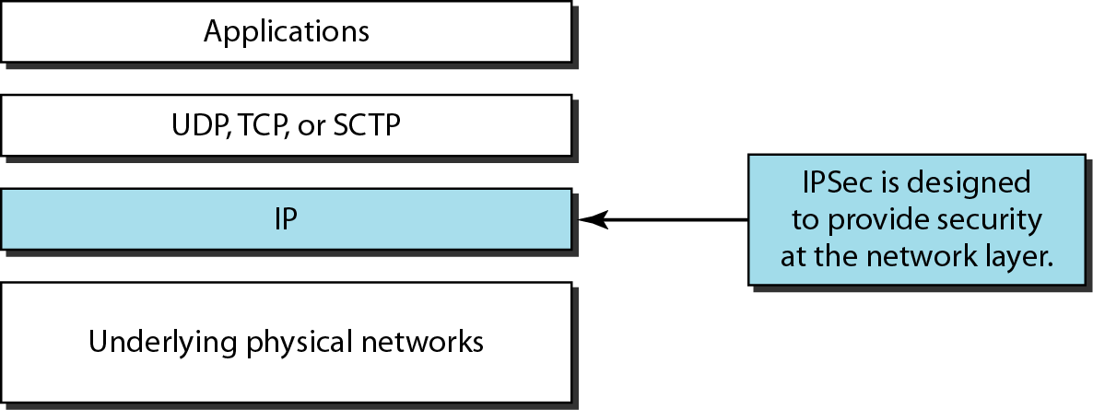
TCP/IP protocol suite and IPSec

Slide 6
Application of IP
IPSec provides the capabilities to secure communications across a LAN, a cross private and public WANs, and a cross the Internet. Examples of its use include:
  Secure branch office connectivity over the Internet.
      e.g. VPN in order to reduce the cost and network management overhead.
  Secure remote access over the Internet.
    e.g. the employee can make a local call to the ISP and gain secured access to a company network without travelling.
  Establishing extranet and intranet connectivity with partner.
    Organizations can communicate with each other securly.
  Enhancing electronic commerce security
    By applying the encryption and authentication for data transmitted.

Slide 7
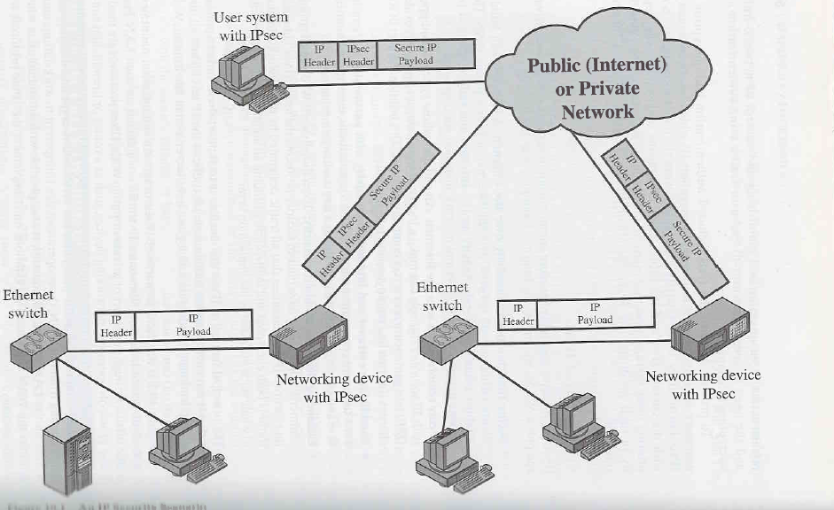
An IPSec Scenario

Slide 8
IPSec
IP services and functions
  Encryption of user data and privacy.
  Authentication of the integrity of a message to ensure that is not changed.
  Protection against certain types of security attacks such as replay attacks.
  Ability for devices to negotiate the security algorithm and the required keys.

Slide 9
IPSec
IPSec operation
When two devices (user hosts, or intermediate devices such as routers and firewalls) want to engage in a secure communication, they set up a secure path between themselves that may traverse across many insecure intermediate systems.
Devices must agree on a set of security protocols such that each one sends data in a format that the other can understand.
Devices must decide on an encryption algorithm.
Devices must exchange keys.
IPSec provide confidentiality and authentication to the IP layer.

Slide 10
IPSec
IPSec core protocols:
A number of different components make up the total package known as IPSec.
  1- IPSec authentication header (AH): allows to verify that the intermediate devices have not changed any of the data in the datagram.
  2- Encapsulated security payload (ESP): AH ensures the integrity of the data in a datagram, but not its privacy. ESP allows encryption to ensure privacy of a message.

Slide 11
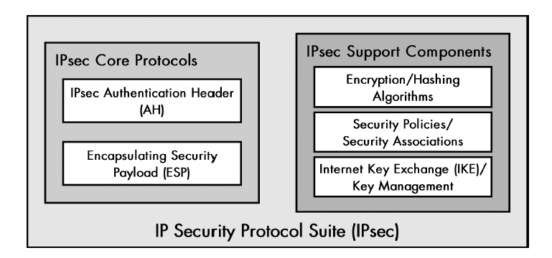
IPSec

Slide 12
IPSec
IPSec architecture:
1.Host-host implementation:
  Putting all IPSec into all hosts devices.
  Enables end to end security between any two devices on the network.
2- Router implementation:
  Is much less work. You make changes to only a few routers instead of hundreds of clients. It provides protection only between pairs of routers.

Slide 13
IPSec
•How to get IPSec into the TCP/IP stack?
1.Integrated architecture:
Under ideal circumstances, we would integrate IPSec’s protocols directly into IP itself. No extra headers or architectural layers are needed.
2- Bump in the stack:
IPSec is made a separate layer between IP and data link layer.

Slide 14
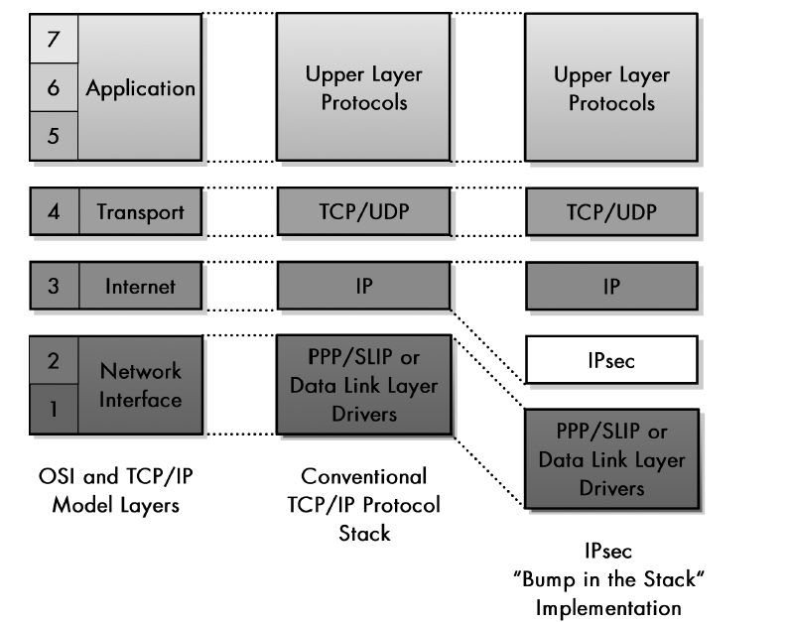
IPSec

Slide 15
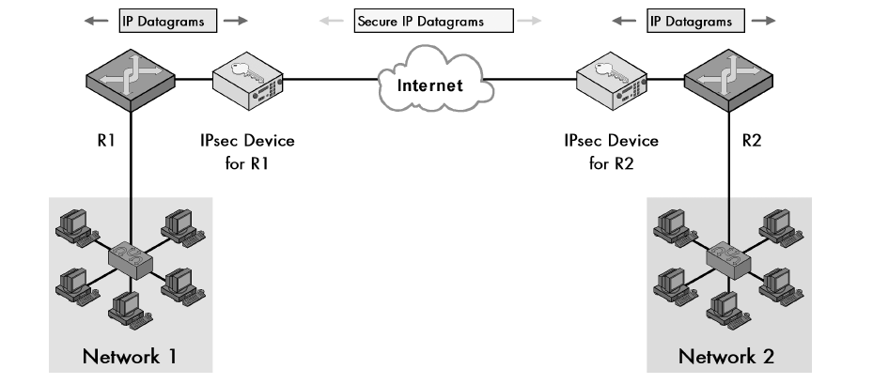
IPSec
3- Bump in the wire:
We add a hardware device that provides IPSec services.

Slide 16
IPSec Modes
1- Transport mode:
IPSec protects the message passed down to IP from the transport layer. The message is processed by AH and /or ESP and the appropriate headers are added.
IPSec in the transport mode does not protect the IP header; it only protects the information coming from the transport layer.
The transport mode is normally used when we need host-to-host protection of data.

Slide 17
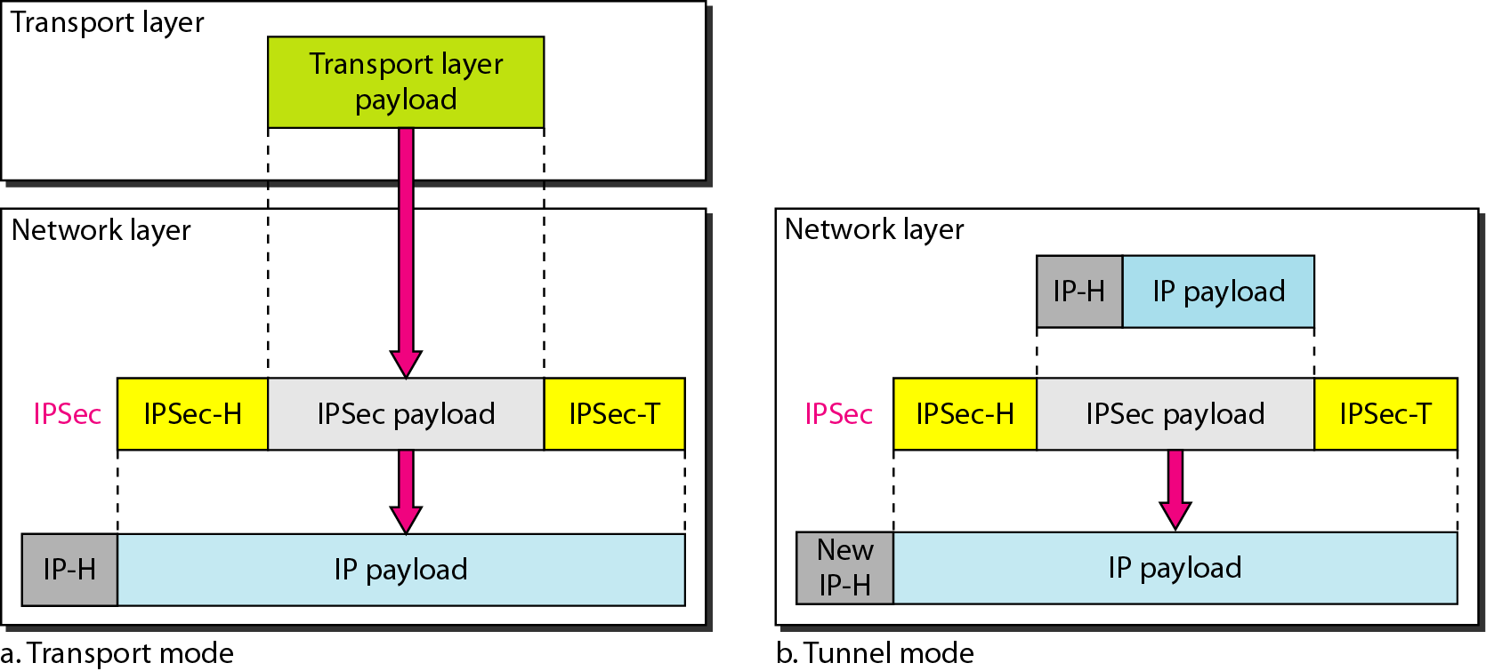
IPSec

Slide 18
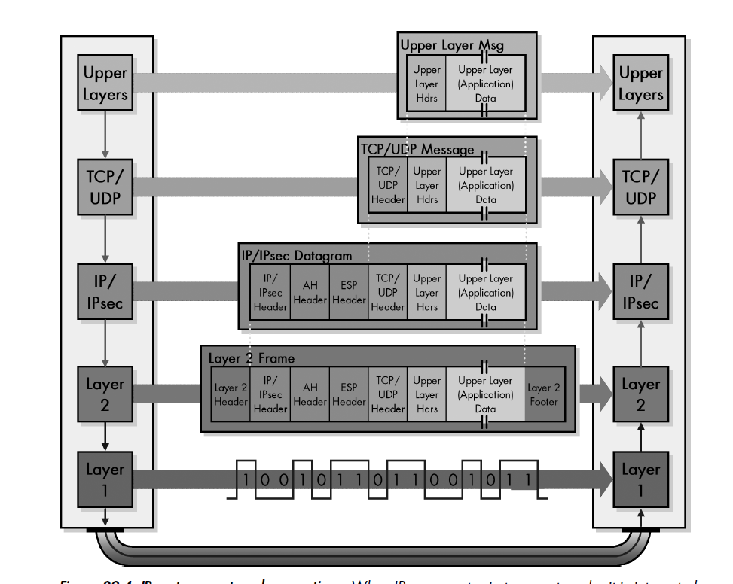
Transport Mode

Slide 19
Tunnel Mode
2- Tunnel mode:
IPSec is used to protect a completely encapsulated IP datagram after the IP header has already been applied to it.
IPSec in tunnel mode protects the original IP header.
It takes an IP packet, including the header, applies IPSec security methods to the entire packet, and then adds a new IP header.
It is used when either the sender or the receiver is not a host.

Slide 20
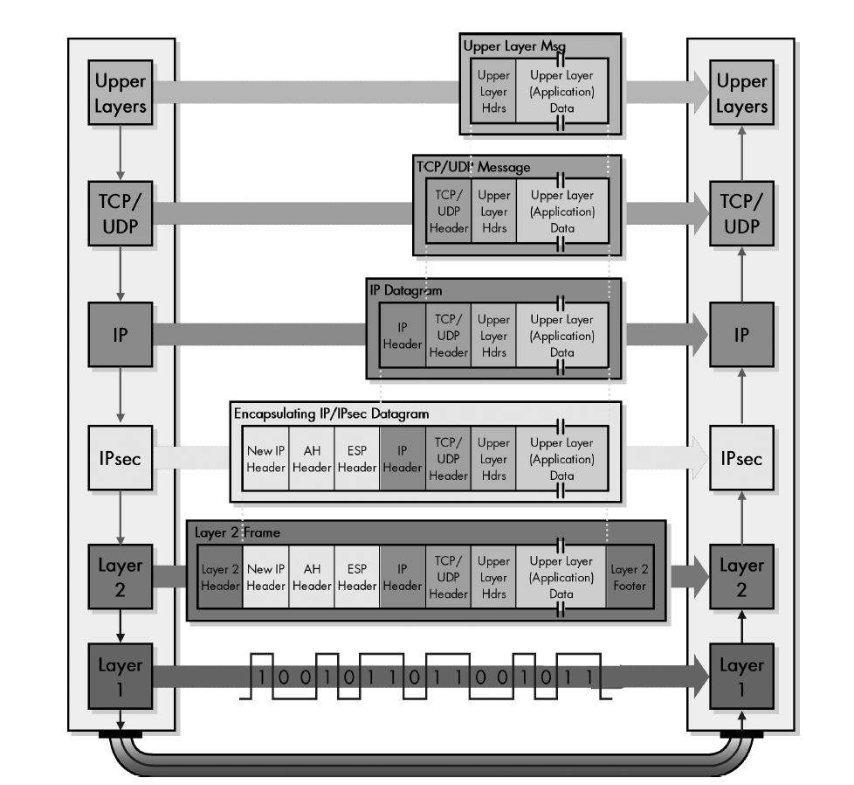
Tunnel Mode

Slide 21
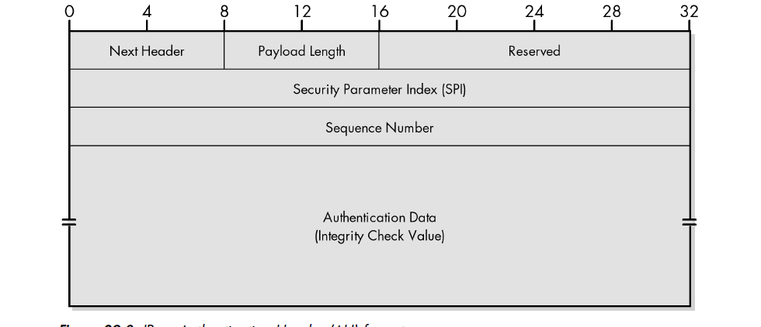
IPSec Authentication Header (AH)

Slide 22
IPSec Authentication Header (AH) Protocol in transport mode
Next header: the 8-bit next-header field defines the type of payload carried by the IP datagram (such as TCP, UDP, ICMP,..).
Payload length: it defines the length of the authentication header
Security Parameter index: the 32-bit security parameter index (SPI) is same for all packets sent during a connection called a security association.
Sequence number: the 32-bit sequence number provides ordering information for a sequence of datagram.

Slide 23
Authentication Header (AH) Protocol in transport mode
Authentication data: Authentication data field is the result of applying a hash function to the entire IP datagram except for the field that are changed during transit e.g. time-to-live.

Slide 24
Encapsulating Security Payload (ESP) Protocol
  Since AH does not provide privacy, IPSec later define an alternative protocol that provides source authentication, integrity, and privacy called Encapsulating Security Payload (ESP) Protocol.
  ESP adds a header and trailer.

Slide 25
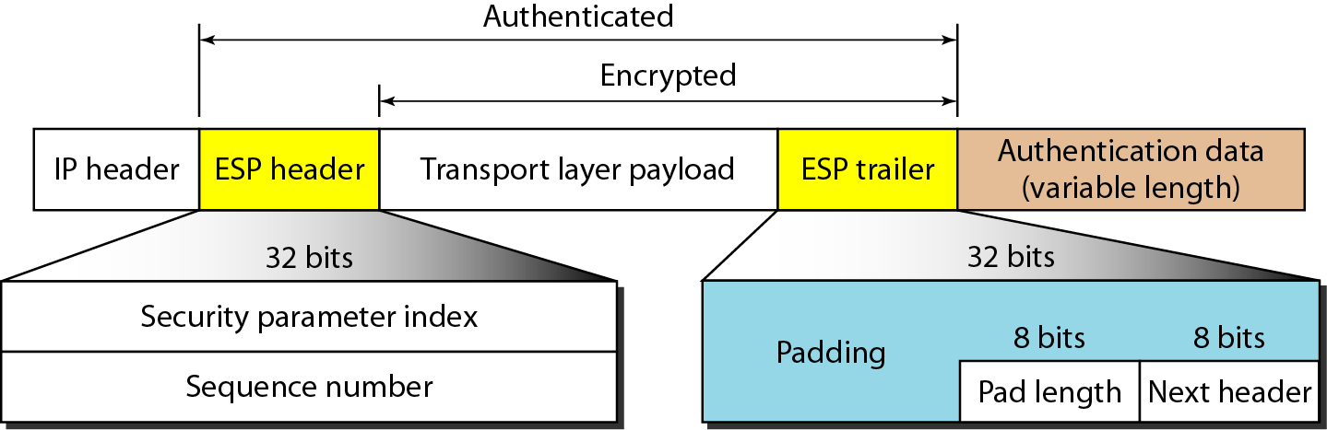
Encapsulating Security Payload (ESP)

Slide 26
Encapsulating Security Payload (ESP) Protocol in transport mode
Security parameter index: the 32-bit security parameter index field is similar to that defined for the AH protocol.
Sequence number: the 32-bit sequence number field is similar to that defined for the AH protocol.
Padding: this variable-length field (0 to 255 bytes) of 0s serves as padding.
Pad length: the 8-bit pad length field defines the number of padding bytes.

Slide 27
Encapsulating Security Payload (ESP) Protocol in transport mode
Next header: the 8-bit next-header field is similar to that defined in the AH Protocol.
Authentication data: it is the result of applying an authentication scheme to part of the datagram.

Slide 28
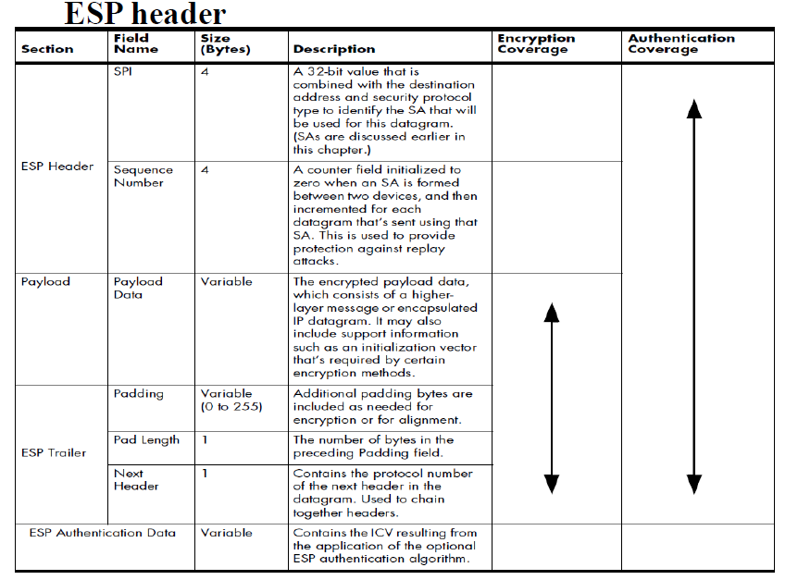

Slide 29
AH Versus ESP
The ESP Protocol was designed after AH Protocol was already in use.
ESP does whatever AH does with additional functionality (privacy).
Why do we need AH ?
  We don’t, but the implementation of AH is already included in some commercial products.

Slide 30
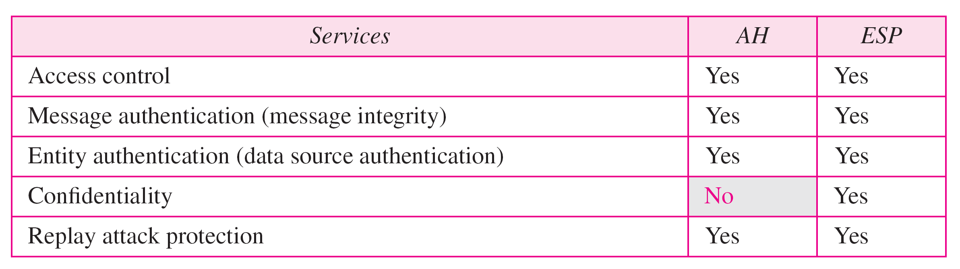
Services Provided by IPSec
The two protocols AH and ESP can provide several security services for packets at the network layer as shown in the table below:

Slide 31
Services Provided by IPSec
Access Control: IPSec provides access control indirectly by using a Security Association Database (SADB).
Message Authentication: the integrity of the message is preserved in both AH and ESP by using the authentication data.
Entity Authentication: The security association and the keyed-hashed digest of the data sent by the sender authenticate the sender in both AH and ESP.

Slide 32
Services Provided by IPSec
Confidentiality: The encryption of the message in ESP provides confidentiality. AH doesn’t provide confidentiality.
Replay Attack Protection ( anti- replay ): both protocols prevent replay attack by using sequence numbers and sliding the window.

Slide 33
Anti-replay mechanism
Each IPSec header contains a unique and an increasing sequence number.
When a security association is created, the sequence number is initialized to 0.
The sequence number is 32 bits long.
The receive window can be any size greater than 32 but 64 is recommended.
The received packets must be new and must fall either inside the window or at the right. Otherwise, they are dropped.

Slide 34
Anti-replay mechanism
If a received packet has a sequence number which is:
-to the left of the current window, the receiver rejects the packet.
-inside the current window, the receiver accepts the packet.
-to the right of the current window, the receiver accepts the packet and advances the window.

Slide 35
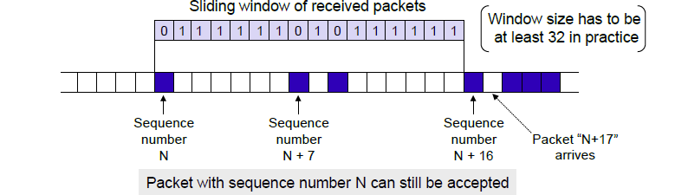
Anti-replay mechanism

Slide 36
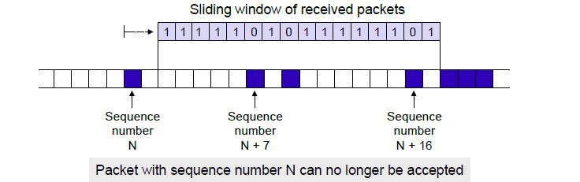
Anti-replay mechanism

Slide 37
IPSec
Some types of messages may need more security; others may need less. Also, exchanges with certain devices may require different processing than others.
To manage all of this complexity, IPSec is equipped with a flexible, powerful way of specifying how different types of datagrams should be handled.

Slide 38
Security Policy and Security Policy Database
Security policies (SP) and the Security Policy Database (SPD)
A security policy is a rule that is programmed into the IPSec implementation. It tells the implementation how to process different datagrams received by the device.
  For example, security policies decide if a particular packet needs to be processed by IPSec or not.
If security is required, the security policy provides general guidelines for how it should be provided. Security policies for a device are stored in the device’s SPD.

Slide 39
Security Association (SA)
It is a mechanism that IPSec used to establish the security parameters.
IP is connectionless protocol ( each datagram is independent of others).
A set of security parameters can be established between a sender and a particular receiver the first time they have communication.
It is called Security Association
Using Security Association , IPSec changes a connectionless protocol (IP) to a connection- oriented protocol.

Slide 40
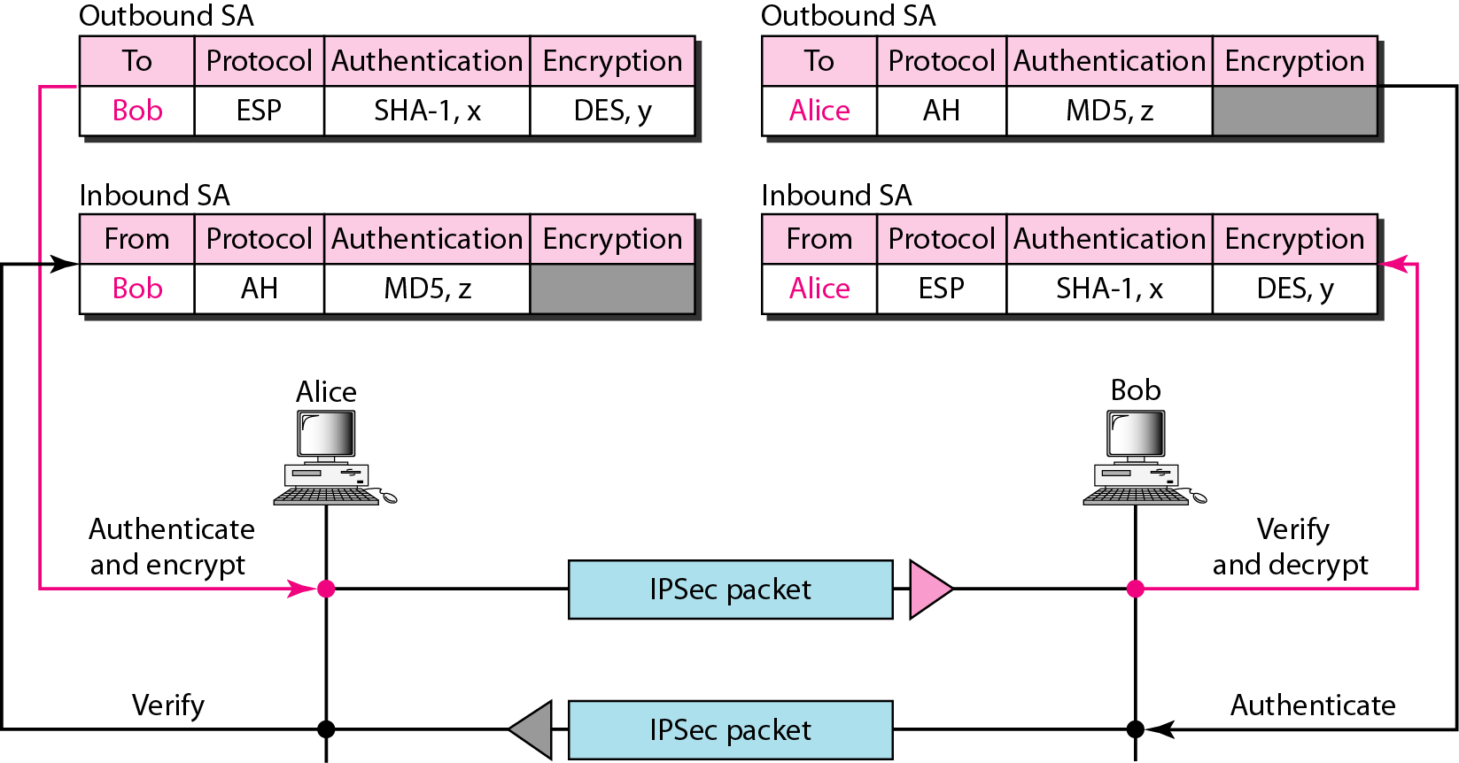
Simple inbound and outbound security associations

Slide 41
Security Association Database (SADB)
What if Alice needs to send to many people and receive from many people too.
She needs to have multiple inbound and outbound SAs.
Thus, SADB is needed to collect those se of SAs.
SADB it is a two-dimensional table with each row defining a single SA.
Normally, there are two SADBs one inbound and one outbound.

Slide 42
Security Parameter Index (SPI)
It is used to distinguish one association from the other.
Each association is defined by a parameter called the Security Parameter Index (SPI).
SPI contains the destination address ( outbound) or source address (inbound) and protocol (AH or ESP). ➔ uniquely identifies an association!

Slide 43
Security Associations(SAs) and the Security Association Database (SAD)
For each inbound packet, IPSec looks up the inbound SA in the SAD based on the SPI and then decrypts the packet.
Actions applied to packets:
  Bypass: allows the transmission of a packet.
  Discard: blocks a packet.
  Protect:

Slide 44
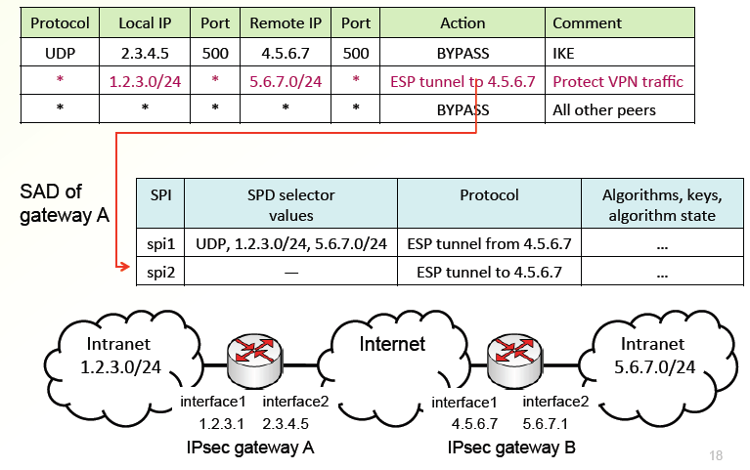
Security Associations(SAs) and the Security Association Database (SAD)

Slide 45
Part 2: Authentication Check Principles

Slide 46
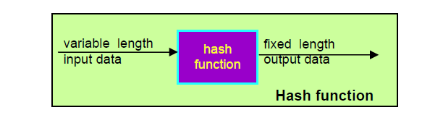
Authentication check principles:
Hash function takes variable length input data and produces fixed length output data.
  SHA-1 (secure hash algorithm) generates 160 bit hash value.
  MD5 (message digit 5) generates 128 bit hash value.

Slide 47
Authentication check principles
The digest that created by a hash function is called a Modification Detection Code (MDC).
The MDC guarantees that the message hasn’t been altered.
In message authentication , we need to know that the message is coming from trusted source ( e.g. Alice not Eve)
Thus, Message Authentication Code (MAC) is used for this purpose.

Slide 48
Message authentication code(MAC):
Message authentication is achieved using a message authentication code (MAC), also known as a keyed hash function.
MACs are used between two parties that share a secret key to authenticate information exchanged between those parties.
A MAC function takes as input a secret key and a data block and produces a hash value, referred to as the MAC.

Slide 49
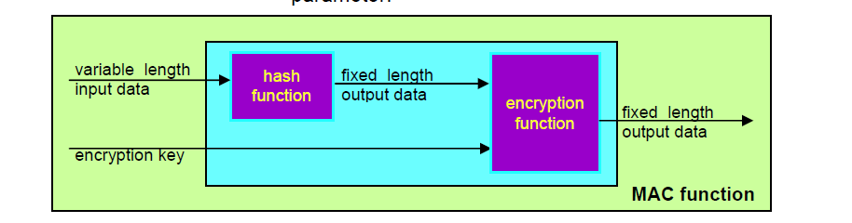
Message authentication code(MAC):

Slide 50
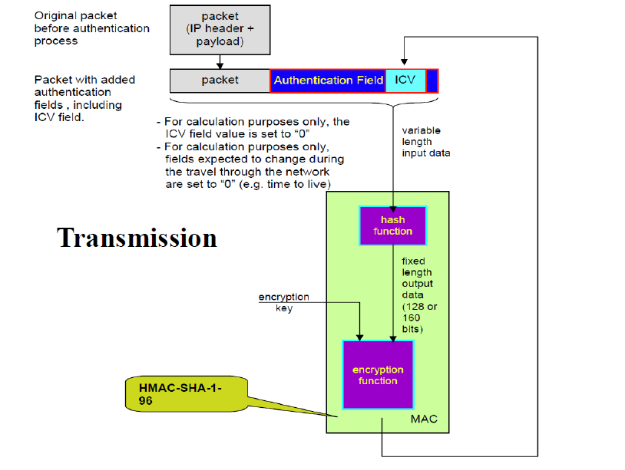
* ICV= Integrity Check Value

Slide 51
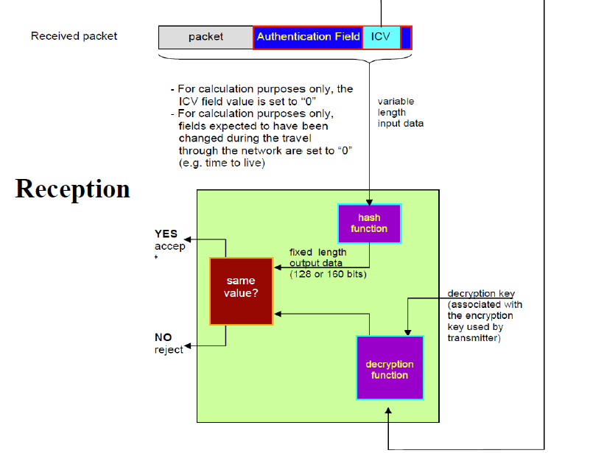

Slide 52
Part 3: Virtual Private Networks (VPN)

Slide 53
Virtual private networks
Problem:
→ You have several geographically separated local area networks that you would like to have connected securely
A virtual private network is a way to simulate a private network over a public network (Internet).
Temporary connections (no real physical presence) are used.
Secure virtual connections are created between two machines, a machine and a network, or two different networks.
Service appears to users as if they were connected directly over a private network

Slide 54
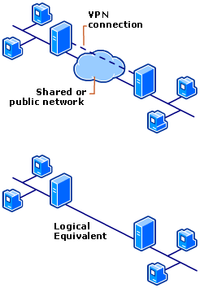
Virtual private networks

Slide 55
Virtual private networks
A VPN solution should provide at least all of the following:
  User authentication: verify the user’s ID and restrict VPN access to authorized users.
  Address management: assign a client’s address on the private network and ensure that private addresses are kept private.
  Data encryption: for ensuring confidentiality.
  Key management: generate and refresh encryption keys.
  Multiprotocol support: handle common protocols used in the public network.

Slide 56
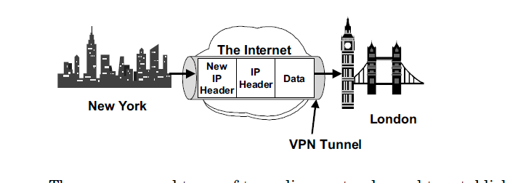
Virtual private networks
Tunneling basics:
  Tunneling is a method to transfer data from one network over another.
  It encapsulates the frame in an additional header.
  Encapsulated packets are then routed between tunnel endpoints over the internetwork.
  Tunnel= logical path.

Slide 57
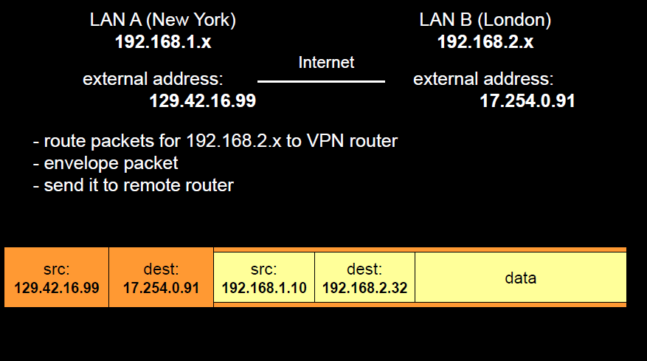
Virtual private networks

Slide 58
Tunneling
How tunneling works ?
Both of the tunnel endpoints must agree to the tunnel and must negotiate about configuration variables, such as address assignement or encryption parameters.
Once the tunnel is established, encapsulated data are sent.
Tunnel server accepts the packet, removes the header and forms data to the target network.

Slide 59
Tunneling
Tunnel types:
Voluntary tunnels: a user or a client computer can issue a VPN request to configure and create a voluntary tunnel. In this case, the user’s computer is a tunnel endpoint and acts as the tunnel client.
Compulsory tunnels: the user’s computer is not a tunnel endpoint. Another device, the remote access server, between the user’s computer and the tunnel server is the tunnel endpoint.

Slide 60
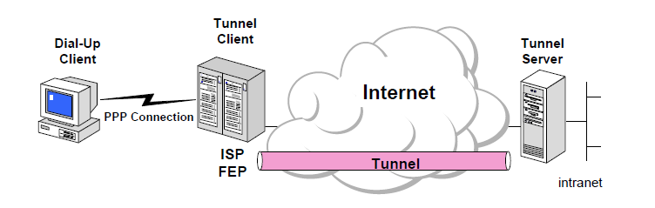
Tunneling
Compulsory tunnels

