Slide 1
NET 536
Network Security
Lecture 3: TCP/IP Possible Attacks

Slide 2
Topic to be covered
TCP/IP possible attacks:
  Denial-of-Service Attack
    Ping flooding
    SYN spoofing
  Packet Sniffing Attack
  Packet Spoofing Attack
  Indirect attacks
    Distributed Denial-of-Service Attack
    Amplifier Attack
    Reflector Attack
  Strategies to prevent attacks

Slide 3
Denial-of-service (DoS)
Denial-of-service (DoS) attack aims at disrupting the authorized use of networks, systems, or applications
  by sending messages which exhaust service provider’s resources ( network bandwidth, system resources, application resources)

Slide 4
Denial-of-service (DoS): how it works?
In a normal connection, the client sends a message asking the server to authenticate it. The server returns the authentication approval (ACK) to the client. The client acknowledges this approval and is then allowed onto the server.
In a denial of service attack, the client sends several requests to the server, filling it up.
All requests have false return addresses and so the server can't find the user when it tries to send the request approval.

Slide 5
Approaches to DoS attacks:
Flooding Attack
  Work by sending a vast number of messages whose processing consumes the limited resource available at the target’s system.
  It takes advantage of a flaw in how most hosts implement this three-way handshake which is an important feature of the TCP/IP protocol.

Slide 6
Types of flooding attacks
Classified based on type of network protocol used to attack
ICMP flood
  Uses ICMP packets , ex: ping flood using echo request
  Typically allowed through, some required
UDP flood
  UDP packets directed to some port number, potential service, on the target system.
  Exploits the target system’s diagnostic echo services to create an infinite loop between two or more UDP services
TCP SYN flood
  Use TCP SYN (connection request packets)
  But for volume packets rather than the system code ( SYN spoofing)

Slide 7
Ping flood attack
The diagnostic “Ping” command is a common network utility used to test connectivity to the specified destination.
It sends TCP/IP ICMP echo request packets to the destination and measures the time taken for the echo response packet to return, it at all.
Usually these packets are sent at a controlled rate; however, the flood option specifies that they should be sent as fast as possible. This is usually specified as “ping-f”.
Notes:
The Internet Control Message Protocol (ICMP) is one of the core protocols of the Internet Protocol Suite.
ICMP messages are typically used for diagnostic or control purposes or generated in response to errors in IP operations.

Slide 8
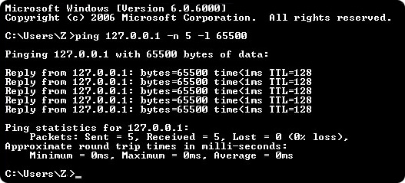
Ping flood attack
Use of ping command options -n -l
Ping of Death
Source: learn-networking.com

Slide 9
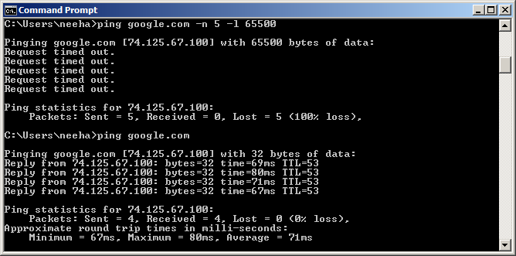
Ping flood attack cont’d ….
Generally useless on larger networks or websites
Source: learn-networking.com

Slide 10
Disadvantage to attacker
The main disadvantage (from the attacker ‘s perspective) of the classical ping flood attack:
  1. Attacker’s source is easily identified
  The source of the attack is explicitly identified and then increasing the chance that the attacker can be identified and legal action taken in response.
  2. Chances of attack flow being reflected back to attacker
  This problems leads the DoS attacker to use forged source address this known as Source Address Spoofing.

Slide 11
SYN spoofing
This attacks the ability of a network server to respond to TCP connection requests by overwhelming the tables used to manage such connections.
Takes advantage of the three-way handshake that occurs any time two systems across the network initiate a TCP connection request.
Unlike usual brute-force attack, not done by exhausting network resources but done by overflowing the system resources (tables used to manage TCP connections)
Require fewer packets to deplete
Consequence: Failure of future connection requests ,thereby denying access to the server for legitimate users

Slide 12
  SYN spoofing
When Host B receives the SYN request from A, it must keep track of the partially opened connection in a "listen queue“; ( e.g. 75 seconds)
Most of server keep track of a very limited number of connections.
Malicious client can exploit the small size of the listen queue by sending multiple SYN requests to a server, but never replying to the SYN&ACK the server sends back.
The server will wait for acknowledgments from the client.
As a result, the server’s listen queue is quickly filled up, and it will stop accepting new connections, until a partially opened connection in the queue is completed or times out.

Slide 13
TCP 3-way connection handshake
Address,
Port number,
Seq x
Recorded in a table of known TCP connections

Slide 14
SYN spoofing cont’d ….
The SYN spoofing attacker directs a very large number of forged connection requests at the targeted server.
These rapidly fill the table of known TCP connections on the server.
Once this table is full, any future requests, including the legitimate requests at the targeted server.

Slide 15
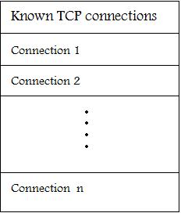
SYN spoofing cont’d ….
If the spoofed address match a real system ( spoofed Client), it will respond with a RST (reset) packet to cancel this unknown connection request. When the server receive the RST packet, it cancel the connection and removes the saved information

Slide 16
Factors considered by attacker for SYN spoofing
The number of sent forged packets are just large enough to exhaust the table but small as compared to a typical flooding attack
Keep sufficient volume of forged requests flowing
  Keep the table constantly full with no timed-out requests
Make sure to use addresses that will not respond to the SYN-ACK with a RST

Slide 17
Factors considered by attacker for SYN spoofingcont’d ….
In order to increase the usage of the known TCP connections table, the attacker ideally wishes to use addresses that will not respond to the SYN-ACK with RST.
This can be done by tow ways:
  Overloading the host that owns the chosen spoofed source address.
  OR
  Using a wide range of random addresses since there are many unused addresses in the Internet. Consequently, a reasonable proportion of randomly generated will not correspond to a real host.

Slide 18
Detecting SYN spoof attack
After the target system has tried to send a SYN/ACK packet to the client and while it is waiting to receive an ACK packet, the existing connection is said to be half open or host in SYN_RECEIVED state
If your system is in this state, it may be experiencing SYN-spoof attack
To determine whether connections on your system are half open, type netstat –a command
This command gives a set of active connections .Check for those in the state SYN_RECEIVED which is an indication of the threat of SYN spoof attack
)

Slide 19
How to prevent DoS attacks
One common method of blocking denial of service attacks is to set a filter, or a sniffer, on a network before a stream of information reaches a site server.
This filter can guard against attacks by looking for pattern of information or requests.
For example, if a pattern comes in frequently, the filter can block messages containing such a pattern and that protects the server from becoming a victim for an attack.

Slide 20
  Packet Sniffing Attack
Packet sniffing is the act of intercepting and reading any or all network traffic that is being transmitted across a shared network communication channel.
Packet sniffing captures network traffic at the Ethernet frame level.
After capture, this data ca be analyzed and sensitive information can be retrieved.
Using a packet analyzer such as Wireshark, the attacker can examine data that is transmitted.
Any data that is not encrypted is readable.
Packet sniffing is a passive attack and it is difficult to detect.

Slide 21
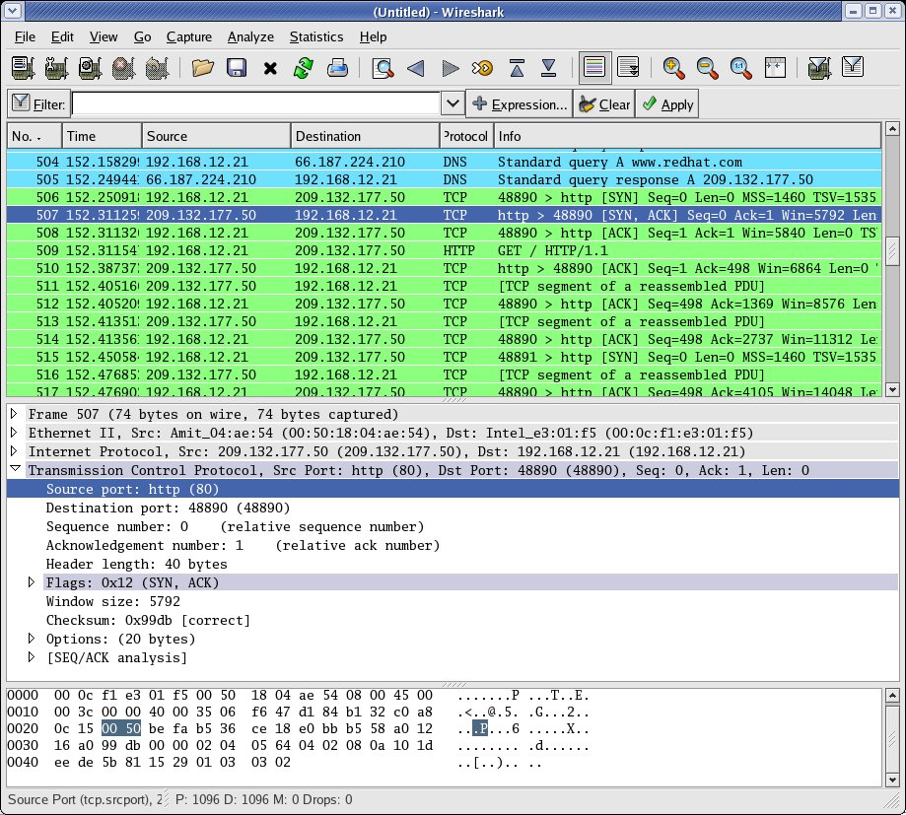
  Wireshark

Slide 22
  Packet Sniffing Attack
The most popular way of connecting computers is through Ethernet. Ethernet protocol works by sending packet information to all the hosts on the same circuit.
The packet header contains the proper address of the destination machine. Only the machine with the matching address is supposed to accept the packet.
A machine that is accepting all packets, no matter what the packet header says, is said to be in promiscuous mode.
The intruder can put a machine into promiscuous mode and by sniffing, compromise all the machines on the net.

Slide 23
  Packet Sniffing Attack
Having used switch-based network, the packet sniffing become a little tougher.
However, the intruder can install remote sniffing programs on servers and routers through which a lot of traffic flows.
Typical items sniffed can be:
  SMTP traffic: Sniffing one of these allows intruder to read the actual email.
  HTTP Basic, Telnet authentication: This allows hacker to read passwords off the wire in clear-text.
  FTP traffic: I t allows attacker to reads files of the wire.
  SQL database: It permits the attacker to read financial transactions and credit card information.

Slide 24
  Packet Sniffing Attack Prevention
There are many solutions to prevent packet sniffing attacks
Authentication schemes such as MD4 and MD5, KERBEROS, and SHA-1 can prevent the clear text transmission of user names and passwords across a network.
Public key encryption programs such as PGP can encrypt electronic mail (E-mail) to prevent the contents from being read.

Slide 25
  Packet Spoofing Attack
The attacker aims to get unauthorized access to computers by sending messages to a computer with an IP address indicating that the message is coming from a trusted port.
Thus, the attacker find an IP address of a trusted port and then modify the packet headers so that it appears that the packets are coming from that port.
This type of attack is considered as active attack.

Slide 26
  Packet Spoofing Attack Prevention
Disable JavaScript in your browser so the attacker will be unable to hide the evidence of the attack.
Make sure your browser's location line is always visible.
Pay attention to the URLs displayed on your browser's location line, making sure they always point to the server you think you are connected to.

Slide 27
Indirect attacks
Single-sourced attacker would be traced
Scaling would be difficult
Instead use multiple and distributed sources
  None of them generates traffic to bring down its own local network
  The Internet delivers all attack traffic to the victim
Thus, victims service is denied while the attackers are still fully operational
Indirect attack types
  Distributed DoS
  Reflector attacks
  Amplifier attacks

Slide 28
Distributed Denial-of-service
Attacker uses multiple compromised user work stations/PCs for DoS by:
  Utilizing vulnerabilities to gain access to these systems
  Installing malicious backdoor programs , thereby making zombies
  Creating botnets: large collection of zombies under the control of attacker
Generally, a control hierarchy is used to create botnets
  Handlers: The initial layer of zombies that are directly controlled by the attacker
  Agent systems: Subordinate zombies that are controlled by handlers
  Attacker sends a single command to handler, which then automatically forwards it to all agents under its control
Example: Tribe Flood Network (TFN), TFN2K

Slide 29
DDoS control hierarchy
Example: Tribe Flood Network (TFN)
  TFN did not spoof source addresses in the attack packet. Rather, it relied on large number of compromised systems and layered command structure
Command-line program
Trojan Program

Slide 30
Reflector and Amplifier attacks
Unlike DDoS attacks, the intermediaries are not compromised
R & A attacks use network systems functioning normally
Generic process:
  A network packet with a spoofed source address is sent to a service running on some network server
  A response to this packet is sent to the spoofed address(victim) by server
  A number of such requests spoofed with same address are sent to various servers
  A large flood of responses overwhelm the target’s network link
Spoofing utilized for reflecting traffic
These attacks are easier to deploy and harder to trace back

Slide 31
Reflection attacks
Direct implementation of the generic process explained before
  Reflector : Intermediary where the attack is reflected
  Make sure the packet flow is similar to legitimate flow
Attacker’s preference: response packet size > original request size
Various protocols satisfying this condition are preferred
  UDP, chargen, DNS, etc
Intermediary systems are often high-capacity network servers/routers
Lack of backscatter traffic
  No visible side-effect
  Hard to quantify

Slide 32
Reflection attack using TCP/SYN
Exploits three-way handshake used to establish TCP connection
  A number of SYN packets spoofed with target’s address are sent to the intermediary
Flooding attack but different from SYN spoofing attack
Continued correct functioning is essential
Many possible intermediaries can be used
  Even if some intermediaries sense and block the attack, many other won’t

Slide 33
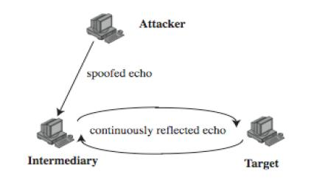
Further variation
Establish self-contained loop(s) between the intermediary and the target system using diagnostic network services (echo,chargen )
Fairly easy to filter and block
Large UDP Packet+
spoofed source

Slide 34
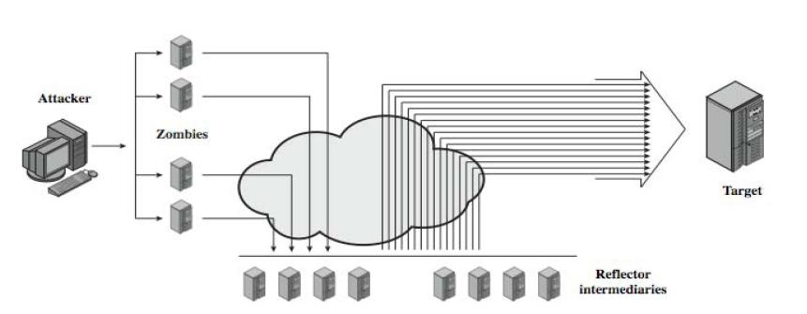
Amplification attacks
Differ in intermediaries generate multiple response packets for each original packet sent

Slide 35
Amplification attacks possibilities
Utilize service handled by large number of hosts on intermediate network
A ping flood using ICMP echo request packets
  Ex: smurf DoS program
Using suitable UDP service
  Ex: fraggle program
TCP service cannot be used

Slide 36
Defense from amplification attack
Not to allow directed broadcasts to be routed into a network from outside

Slide 37
DNS amplification attacks
DNS servers is the intermediary system
Exploit DNS behavior to convert a small request to a much larger response
  60 byte request to 512 – 4000 byte response
Sending DNS requests with spoofed source address being the target to the chosen servers
Attacker sends requests to multiple well connected servers, which flood target
  Moderate flow of packets from attacker is sufficient
  Target overwhelmed with amplified responses from server

Slide 38
Teardrop
This DoS attack affects Windows 3.1, 95 and NT machines and Linux versions previous to 2.0.32 and 2.1.63
Teardrop is a program that sends IP fragments to a machine connected to the Internet or a network
Teardrop exploits an overlapping IP fragment bug
  The bug causes the TCP/IP fragmentation re-assembly code to improperly handle overlapping IP fragments
  A 4000 bytes of data is sent as
    Legitimately (Bytes 1-1500) (Bytes 1501 – 3000) (Bytes 3001-4500)
    Overlapping (Bytes 1-1500) (Bytes 1501 – 3000) (Bytes 1001-3600)
This attack has not been shown to cause any significant damage to systems
The primary problem with this is loss of data
Source: Fadia (2007)

Slide 39
Cyberslam
DDoS attack in a different style
Zombies DO NOT launch a SYN Flood or issue dummy packets that will congest the Web server’s access link
Zombies fetch files or query search engine databases at the Web server
From the web server’s perspective, these zombie requests look exactly like legitimate requests
so the server ends up spending lot of its time serving zombies,causing DoS to legitimate users

Slide 40
Techniques to counter cyberslam
Password authentication
  Cumbersome to manage for a site like Google
  Attacker might simply DDoS the password checking mechanism
Computational puzzles
  Computation burden quite heavy compared to service provided
Graphical puzzles
Kill-bots suggested in [Kandula 2005]
Source: Kandula (2005)

Slide 41
Attack prevention
Limit ability of systems to send spoofed packets
  Filtering done as close to source as possible by routers/gateways
  Reverse-path filtering ensure that the path back to claimed source is same as the current packet’s path
    Ex: On Cisco router “ip verify unicast reverse-path” command
Rate controls in upstream distribution nets
  On specific packet types
  Ex: Some ICMP, some UDP, TCP/SYN
Use modified TCP connection handling
  Use SYN-ACK cookies when table full
  Or selective or random drop when table full

Slide 42
Attack prevention cont’d ….
Block IP broadcasts
Block suspicious services & combinations
Manage application attacks with “puzzles” to distinguish legitimate human requests
Good general system security practices
Use mirrored and replicated servers when high performance and reliability required

Slide 43
Responding to attacks cont’d ….
Identify the type of attack
  Capture and analyze packets
  Design filters to block attack traffic upstream
  Identify and correct system application bugs
Have ISP trace packet flow back to source
  May be difficult and time consuming
  Necessary if legal action desired
Implement contingency plan
Update incident response plan

Slide 44
Glossary
backdoor programs: is a secret entry point into a program that allows someone who is aware of the backdoor to gain access without going through the usual security access procedures.
Zombies (bot): is a program that activated on an infected machine that is activated to launch attacks on the other machines.
Botnet: the collection of bots often is capable of acting in a coordinated manner such a collection is called botnet.
Spyware: Software that collects information from a computer and transmits it to another system.
Adware: Advertising that id integrated into software . It can result in pop-up ads or redirection of a browser to a commercial site.
Trojan horse: is a program that appears to have a useful function, but also has a hidden and potentially a malicious function that evades security mechanisms.
Rootkit: Set of hacker tools used after attacker has broken into a computer system and gained root-level access.
Chargen: is the character generator diagnostic service that returns a stream of characters to the client that connect to it.

