Slide 1
NET 536
Network Security
Lab 3: IDSs Exercises

Slide 2
Question # 1
A taxicab was involved in a fatal hit-and-run accident at night. Two cab companies, the Green and the Blue, operate in the city. You are told that:
  • 85% of the cabs in the city are Green and 15% are Blue.
  • A witness identified the cab as Blue.
The court tested the reliability of the witness under the same circumstances that existed on the night of the accident and concluded that the witness was correct in
identifying the color of the cab 80% of the time.
What is the probability that the cab involved in the incident was Blue rather than Green?

Slide 3
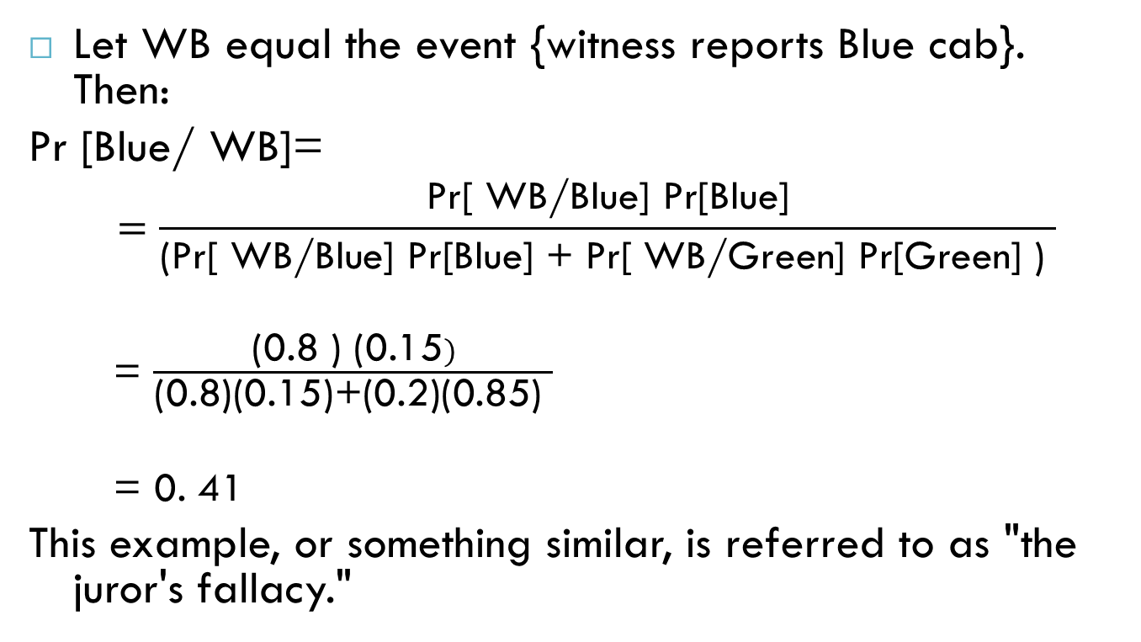
Answer Q#1
Let WB equal the event {witness reports Blue cab}. Then:
Pr [Blue/ WB]=
  $$=\frac{\text{Pr}\text{[ }\text{WB}\text{/}\text{Blue}\text{] }\text{Pr}\text{[}\text{Blue}\text{]}}{\text{(}\text{Pr}\text{[ }\text{WB}\text{/}\text{Blue}\text{] }\text{Pr}\text{[}\text{Blue}\text{] + }\text{Pr}\text{[ }\text{WB}\text{/}\text{Green}\text{] }\text{Pr}\text{[}\text{Green}\text{] ) }}$$
  = $\frac{\text{(}\text{0.8 }\text{) (}\text{0.15})}{\text{(}\text{0.8}\text{)(}\text{0.15}\text{)+(}\text{0.2}\text{)(}\text{0.85}\text{) }}$
  = 0. 41
This example, or something similar, is referred to as "the juror's fallacy."

Slide 4
Question#2
Assume that passwords are selected from four-character combinations of 26 alphabetic characters. Assume that an adversary is able to attempt passwords at a rate of
one per second.
a. Assuming no feedback to the adversary until each attempt has been completed, what is the expected time to discover the correct password?
b. Assuming feedback to the adversary flagging an error as each incorrect character is entered, what is the expected time to discover the correct password?

Slide 5
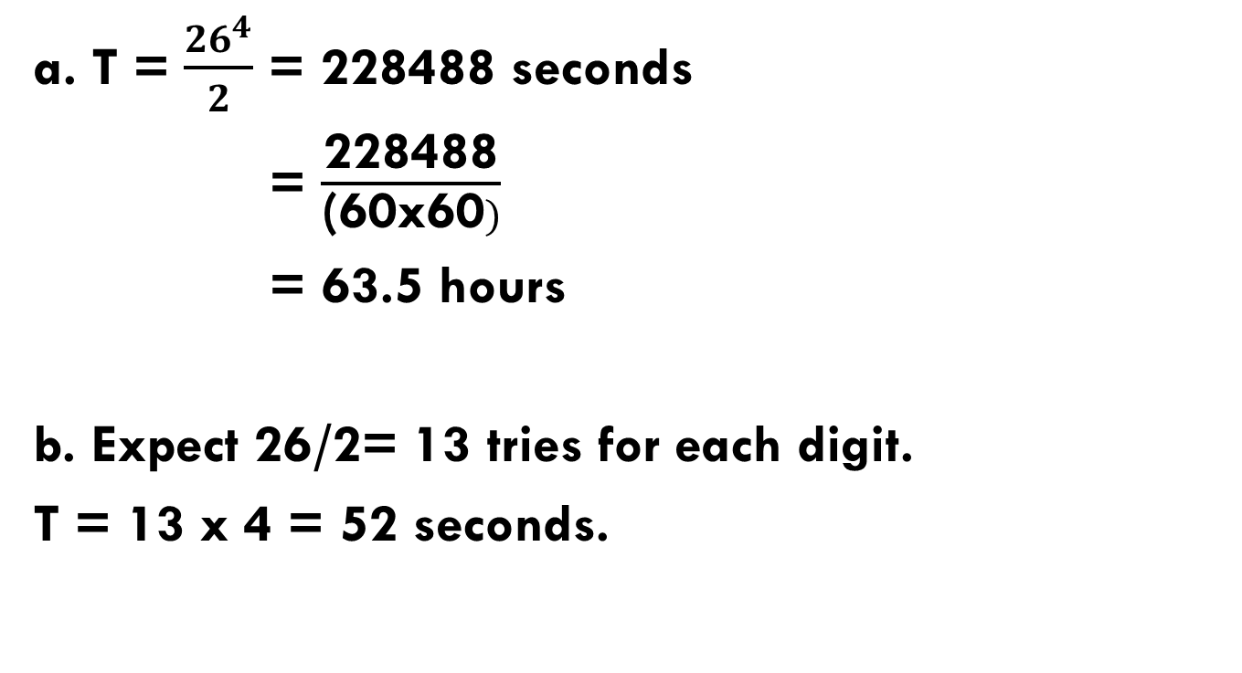
Answer Q#2
a. T = $\frac{{26}^{4}}{2}$ = 228488 seconds
= $\frac{\text{228488}}{\text{(}\text{60}\text{x}\text{60})}$
= 63.5 hours
b. Expect 26/2= 13 tries for each digit.
T = 13 x 4 = 52 seconds.

Slide 6
Question#3
Assume that passwords are limited to the use of the 95 printable ASCII characters and that all passwords are 10 characters in length. Assume a password cracker with an encryption rate of 6.4 million encryptions per second.
How long will it take to test exhaustively all possible passwords on a UNIX system?

Slide 7
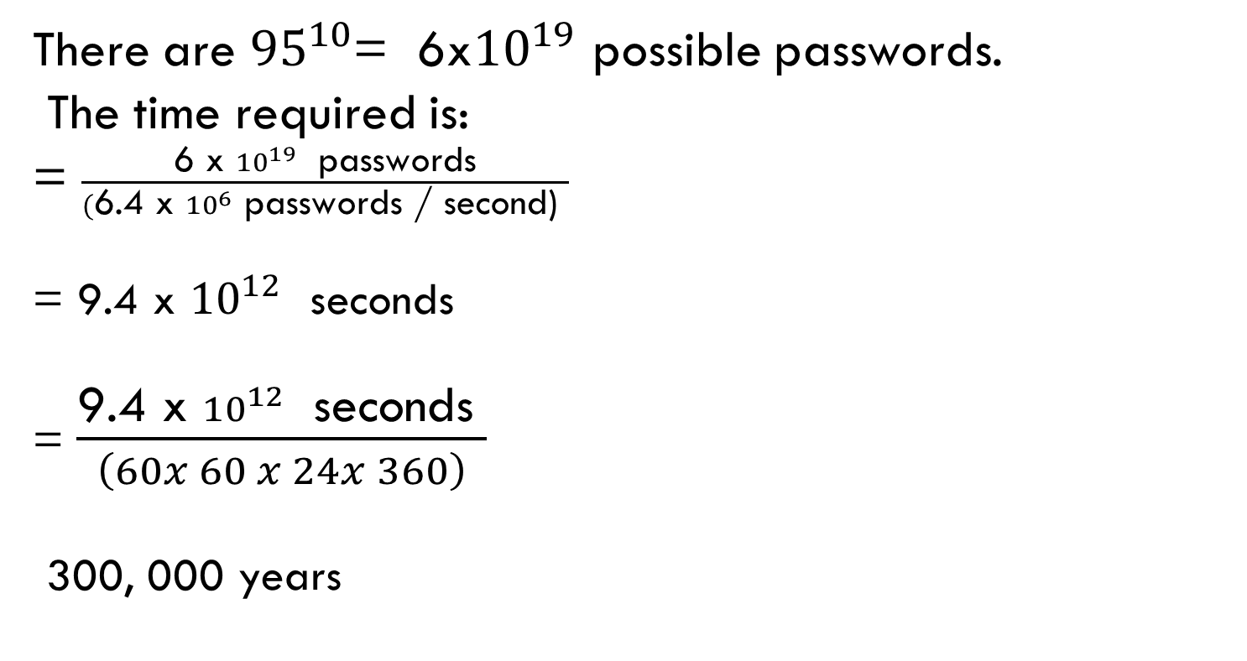
Answer Q#3
There are ${95}^{10}$= 6x${10}^{19 }$possible passwords.
The time required is:
= $\frac{\text{6 }\text{x} {10}^{19 } \text{passwords}}{(\text{6.4 }\text{x} {10}^{6} \text{passwords}\text{ / }\text{second}\text{) }}$
= 9.4 x ${10}^{12 }$ seconds
= $\frac{\text{9.4 }\text{x} {10}^{12 } \text{seconds} }{\left(60x 60 x 24x 360\right)}$
300, 000 years

