Slide 1
NET 536
Network Security
Lecture 6: Digital Signature

Slide 2
lecture contents:
Introduction
RSA Digital Signature
ElGamal Digital Signature
DSA

Slide 3
Introduction
Digital signature is a data string which associates a message (in digital form) with some originating entity.
Digital signature verification is a method for verifying that a digital signature is authentic (was indeed created by the specific entity).
The main difference from a handwritten signature is that digital signature of a message is intimately connected with the message, and for different messages is different, whereas the handwritten signature is adjoined to the message and always looks the same.

Slide 4
Digital Signature Overview
  Based on asymmetric crypto - Example: RSA
Properties of a Digital Signature:
  Verification of the validity of a digital signature needs only the public key
  Only the owner of the corresponding private key can produce a valid signature
  There is also MAC (Message Authentication Code) – signing using a shared key (based on symmetric cryptography)

Slide 5
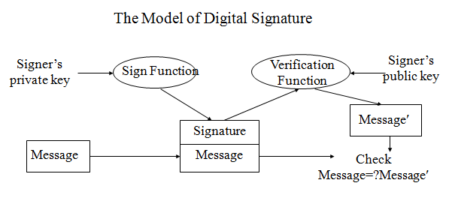
The Model of Digital Signature

Slide 6
RSA Digital Signature
Rivest, Shamir, and Adleman proposed in 1978.
Construction:
1. Choose two large prime numbers P and Q, then compute
N=P×Q.
2. Select an integer e such that gcd(e, φ(N))=1.
3. Compute d such that e×d mod φ(N)=1.
4. Public key = (N, e).
5. Private key = (P, Q, d).

Slide 7
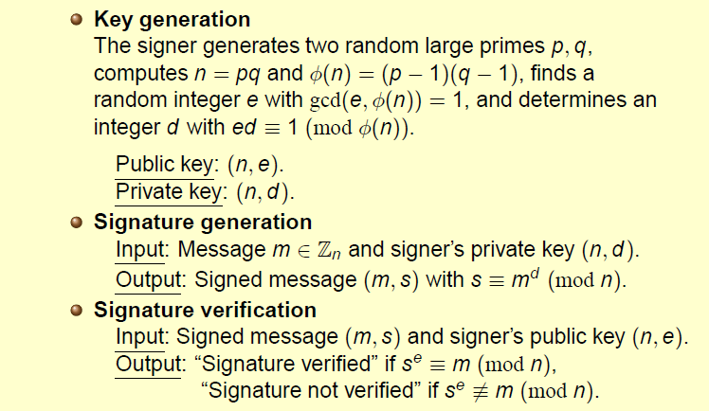
RSA Digital Signature

Slide 8
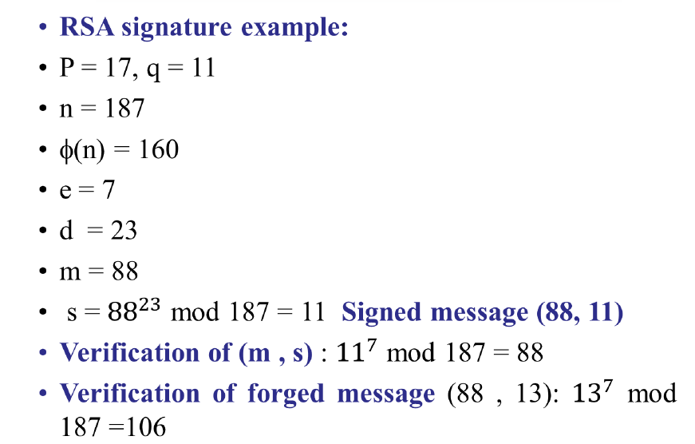
RSA Digital Signature Example

