Slide 1
NET 536
Network Security
Lecture 9: Radix-64 Tutorial

Slide 2
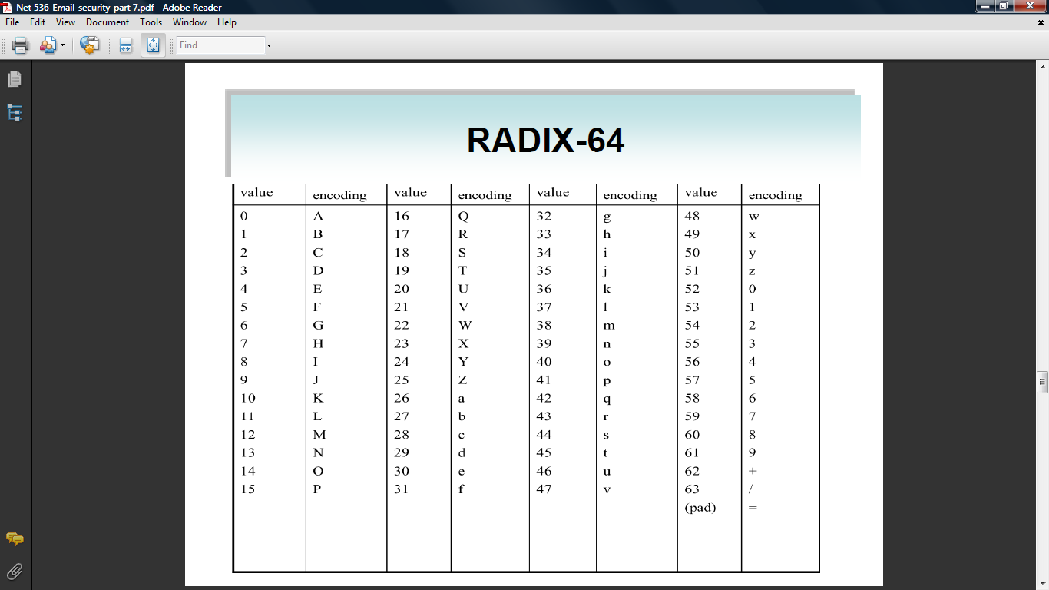
Radix-64 Encoding

Slide 3
Printable Encoding of Binary Data into Radix-64 Format
24 bits
6 bits
6 bits
6 bits
6 bits
R64
R64
R64
R64
32 bits
8 bits
8 bits
8 bits
8 bits

Slide 4
Radix-64 Example
Consider the 24-bit raw text sequence :
00100011 01011100 10010001
Which can be expressed in hexadecimal as:
235C91 hex
1- arrange the input in blocks of 6 bits:
001000 110101 110010 010001
2- extract 6-bit decimal values
8 53 50 17

Slide 5
Radix-64 Example
3- look up in the table and find the radix-64 encoing:
8 ➔ I
53➔ 1
50➔ Y
17➔ R
Thus the Radix-64 Encoding of Input data
Would be in character representation :
I1YR
In binary using ASCII code ( 8-bits, zero parity):
01001001 00110001 01111001 01010010
Hexadecimal representation
49317952

Slide 6
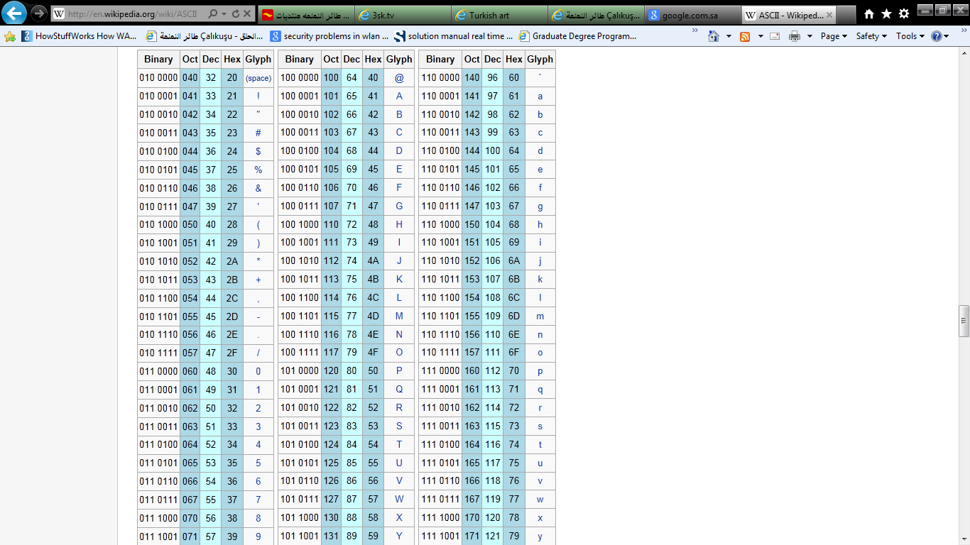
ASCII

